Slide 1
A Possible Theory of connections of ancient Halloween to a biblical account

Slide 2
THERE ARE FIVE FACTORS THAT CONSISTS OF A FEAST

Slide 3
THERE ARE FIVE FACTORS THAT CONSISTS OF A FEAST
A god/deity to worship and offer sacrifices to

Slide 4
THERE ARE FIVE FACTORS THAT CONSISTS OF A FEAST
A god/deity to worship and offer sacrifices to
An appointed day and month for the feast

Slide 5
THERE ARE FIVE FACTORS THAT CONSISTS OF A FEAST
A god/deity to worship and offer sacrifices to
An appointed day and month for the feast
Priests

Slide 6
THERE ARE FIVE FACTORS THAT CONSISTS OF A FEAST
A god/deity to worship and offer sacrifices to
An appointed day and month for the feast
Priests
Sacrifices

Slide 7
THERE ARE FIVE FACTORS THAT CONSISTS OF A FEAST
A god/deity to worship and offer sacrifices to
An appointed day and month for the feast
Priests
Sacrifices
Food to feast

Slide 8
SAMHAIN

Slide 9
What Is Samhain? What to Know About the Ancient Pagan Festival That Came Before Halloween Source: https://time.com/5434659/halloween-pagan-origins-in-samhain/

Slide 10
What Is Samhain? What to Know About the Ancient Pagan Festival That Came Before Halloween Source: https://time.com/5434659/halloween-pagan-origins-in-samhain/
For the Celts, who lived during the Iron Age in what is now Ireland, Scotland, the U.K. and other parts of Northern Europe, Samhain (meaning literally, in modern Irish, “summer’s end”) marked the end of summer and kicked off the Celtic new year. Ushering in a new year signaled a time of both death and rebirth, something that was doubly symbolic because it coincided with the end of a bountiful harvest season and the beginning of a cold and dark winter season that would present plenty of challenges.

Slide 11
What Is Samhain? What to Know About the Ancient Pagan Festival That Came Before Halloween Source: https://time.com/5434659/halloween-pagan-origins-in-samhain/
Notice that it said that meaning was derived from the “modern Irish”, and not from ancient times.

Slide 12
Ancient Origins of Halloween Source: https://www.history.com/topics/halloween/history-of-halloween

Slide 13
Ancient Origins of Halloween [Date] Source: https://www.history.com/topics/halloween/history-of-halloween
Halloween’s origins date back to the ancient Celtic festival of Samhain (pronounced sow-in). The Celts, who lived 2,000 years ago, mostly in the area that is now Ireland, the United Kingdom and northern France, celebrated their new year on November 1.

Slide 14
Ancient Origins of Halloween [date] Source: https://www.history.com/topics/halloween/history-of-halloween
This day marked the end of summer and the harvest and the beginning of the dark, cold winter, a time of year that was often associated with human death

Slide 15
Ancient Origins of Halloween [date] Source: https://www.history.com/topics/halloween/history-of-halloween
Celts believed that on the night before the new year, the boundary between the worlds of the living and the dead became blurred. On the night of October 31 they celebrated Samhain, when it was believed that the ghosts of the dead returned to earth.

Slide 16
Ancient Origins of Halloween [date] Source: https://www.history.com/topics/halloween/history-of-halloween
ALL SAINT’S DAY
Pope Gregory III later expanded the festival to include all saints as well as all martyrs, and moved the observance from May 13 to November 1.

Slide 17
Ancient Origins of Halloween [date] Source: https://www.history.com/topics/halloween/history-of-halloween
ALL SAINT’S DAY
Pope Gregory III later expanded the festival to include all saints as well as all martyrs, and moved the observance from May 13 to November 1.

Slide 18
Ancient Origins of Halloween [date] Source: https://www.history.com/topics/halloween/history-of-halloween
ALL SAINT’S DAY
By the 9th century, the influence of Christianity had spread into Celtic lands, where it gradually blended with and supplanted older Celtic rites.

Slide 19
Ancient Origins of Halloween [date] Source: https://www.history.com/topics/halloween/history-of-halloween
ALL SAINT’S DAY
In 1000 A.D., the church made November 2 All Souls’ Day, a day to honor the dead. It’s widely believed today that the church was attempting to replace the Celtic festival of the dead with a related, church-sanctioned holiday.

Slide 20
Ancient Origins of Halloween [date] Source: https://www.history.com/topics/halloween/history-of-halloween
ALL SAINT’S DAY
All Souls’ Day was celebrated similarly to Samhain, with big bonfires, parades and dressing up in costumes as saints, angels and devils.

Slide 21
Ancient Origins of Halloween [date] Source: https://www.history.com/topics/halloween/history-of-halloween
ALL SAINT’S DAY
The All Saints’ Day celebration was also called All-hallows or All-hallowmas (from Middle English Alholowmesse meaning All Saints’ Day) and the night before it, the traditional night of Samhain in the Celtic religion, began to be called All-Hallows Eve and, eventually, Halloween.

Slide 22
Ancient Origins of Halloween [deity] Source: https://www.history.com/topics/halloween/history-of-halloween
By 43 A.D., the Roman Empire had conquered the majority of Celtic territory. In the course of the 400 years that they ruled the Celtic lands, two festivals of Roman origin were combined with the traditional Celtic celebration of Samhain.

Slide 23
Ancient Origins of Halloween [DEITY] Source: https://www.history.com/topics/halloween/history-of-halloween
By 43 A.D., the Roman Empire had conquered the majority of Celtic territory. In the course of the 400 years that they ruled the Celtic lands, two festivals of Roman origin were combined with the traditional Celtic celebration of Samhain.

Slide 24
Ancient Origins of Halloween [DEITY] Source: https://www.history.com/topics/halloween/history-of-halloween
The first was Feralia, a day in late October when the Romans traditionally commemorated the passing of the dead.

Slide 25
Ancient Origins of Halloween [DEITY] Source: https://www.history.com/topics/halloween/history-of-halloween
The second was a day to honor Pomona, the Roman goddess of fruit and trees. The symbol of Pomona is the apple, and the incorporation of this celebration into Samhain probably explains the tradition of bobbing for apples that is practiced today on Halloween.

Slide 26
A COMPARISON OF THIS WOrD

Slide 27
A COMPARISON OF THIS WORD
Pronounced “saw-win”

Slide 28
A COMPARISON OF THIS WORD
Pronounced “saw-win”
Spelled “Sahmain”

Slide 29
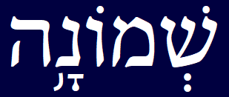
A COMPARISON OF THIS WORD
Pronounced “saw-win”
Spelled “Sahmain”

Slide 30
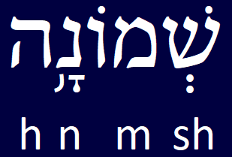
A COMPARISON OF THIS WORD
Pronounced “saw-win”
Spelled “Sahmain”

Slide 31
A COMPARISON OF THIS WORD
Pronounced “saw-win”
Spelled “Sahmain”
Spelled
“Shemonah”

Slide 32
A COMPARISON OF THIS WORD
Sahmain
Shemonah

Slide 33
A COMPARISON OF THIS WORD
Sahmain
Shemonah
Same basic consonants

Slide 34
CALENDAR

Slide 35
GREGORIAN CALENDAR COMPARISON TO HEBReW CALENDAR

Slide 36
GREGORIAN CALENDAR COMPARISON TO HEBReW CALENDAR
In generic format, the Hebrew calendar generally starts halfway in the Gregorian calendar.

Slide 37
GREGORIAN CALENDAR COMPARISON TO HEBReW CALENDAR

Slide 38
GREGORIAN CALENDAR COMPARISON TO HEBReW CALENDAR

Slide 39
GREGORIAN CALENDAR COMPARISON TO HEBReW CALENDAR
Approximation of halfway period in the Hebrew calendar

Slide 40
GREGORIAN CALENDAR COMPARISON TO HEBReW CALENDAR

Slide 41
GREGORIAN CALENDAR COMPARISON TO HEBReW CALENDAR
October

Slide 42
GREGORIAN CALENDAR COMPARISON TO HEBReW CALENDAR
October
Latin “Octo”

Slide 43
GREGORIAN CALENDAR COMPARISON TO HEBReW CALENDAR
October
Latin “Octo”
Eight

Slide 44
GREGORIAN CALENDAR COMPARISON TO HEBReW CALENDAR

Slide 45
HERITage

Slide 46
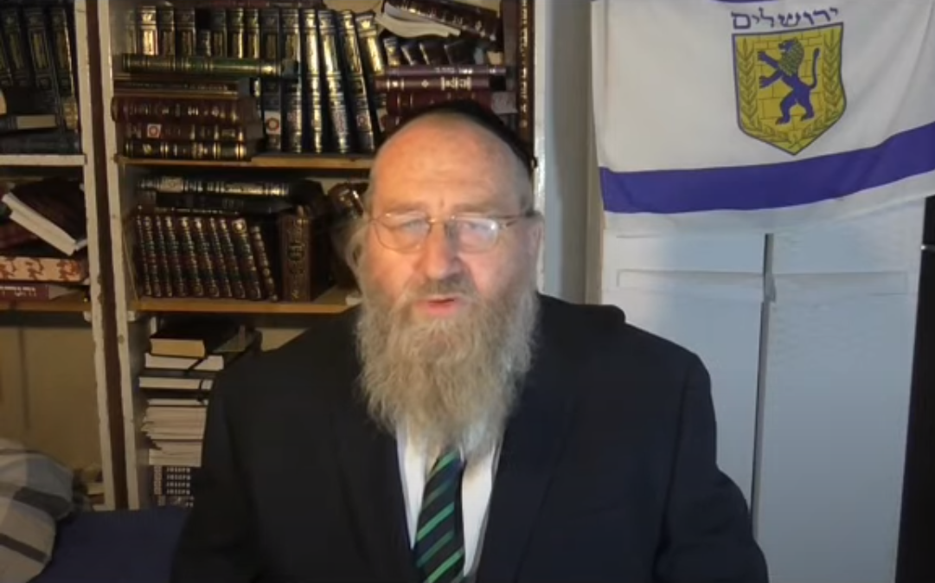

Slide 47
Heritage YAIR DAVIDIY

Slide 48
Heritage YAIR DAVIDIY
Chasidic Jew

Slide 49
Heritage YAIR DAVIDIY
Chasidic Jew
Born in Australia

Slide 50
Heritage YAIR DAVIDIY
Chasidic Jew
Born in Australia
Living in Jerusalem, Israel

Slide 51
Heritage YAIR DAVIDIY
Chasidic Jew
Born in Australia
Living in Jerusalem, Israel
Wrote various books relating to the lost tribes of Israel

Slide 52
Yair Davidiy ANCESTRY: THE HEBREW IDENTITY OF CELTIC RACES (2015)

Slide 53
Yair Davidiy ANCESTRY: THE HEBREW IDENTITY OF CELTIC RACES (2015)
Chapter 10 “Moses, Ireland and Britain”, p. 109
Quoting Louis Hyman from “The Jews of Ireland”, Jerusalem, Israel, 1972, p. 1
“It is stated in very old copies of The Book of Invasions and other ancient documents that it was the Mosaic Law that the Milesians brought into Errin [i.e. Ireland] at their coming; that it had been learned and received from Moses in Egypt by Cae Cain Beathach, who was himself and Israelite, who had been sent into Egypt to learn the language of that country by the great master, Fenius Farsaith, from whom the Milesian brothers, who conquered Errin, are recorded to have been the twenty second generation in descent; and it is stated in the preface to Seanchas Mord that this was the law of Errin at the time of the coming of St. Patrick”.

Slide 54
Yair Davidiy ANCESTRY: THE HEBREW IDENTITY OF CELTIC RACES (2015)
Chapter 10 “Moses, Ireland and Britain”, p. 112, subtitled “The Druids were Negative!”
“The Druids should be romanticized. Apart from regular animal offerings they also practiced human sacrifice and probably ritual cannibalism as well. They worshipped “Bel” the sun-god meaning the Cannanite “Baal”. They also worshipped other foreign idols including Esus who represented Esau the forefather of Edom who had been involved together with Assyria in transporting Israelite captives to the west. The possibility however exists that together with these nefarious customs there were also remnants of Hebraic practices. Not only that but even some of their pagan practices may also help us establish origins from the land of Israel”.

Slide 55
Yair Davidiy ANCESTRY: THE HEBREW IDENTITY OF CELTIC RACES (2015)
Chapter 10 “Moses, Ireland and Britain”, p. 118, subtitled “King Jeroboam of Israel and the Bull Calves”
“”KISS THE CALVES”. Egalim [in the Hebrew] is the plural of bull-calves. These were metallic calves of the Northern Kingdom. At first these calves were made of gold but the Assyrians in their incursions may have taken them away. The replacements were apparently made of silver. Their worshippers would kiss these idols. The Cimbri carried the metal statue of a bull with them in their migrations. They may have offered up human sacrifice to them! The rationale behind human sacrifice is not much different from that used in our day to justify abortions. Pliny the Elder (16:95) describes a religious ceremony in which Druids dressed in white in Gaul climbed a sacred oak, cut down the mistletoe growing on it, and then sacrificed two white bulls and used the mistletoe to cure infertility. A bull with three horns (representing deity) is depicted on coins from cauldron which was found in Denmark but has been attributed a Celtic provenance. Bulls and the sacrifice of bulls are mentioned often in relation to the Druids. The bull is believed to have been sacred to the god Esus whose name is derived from the Phoenician Ousoos meaning Esau.”.

Slide 56
The next slide shows the migrations of the northern tribes of israel

Slide 57
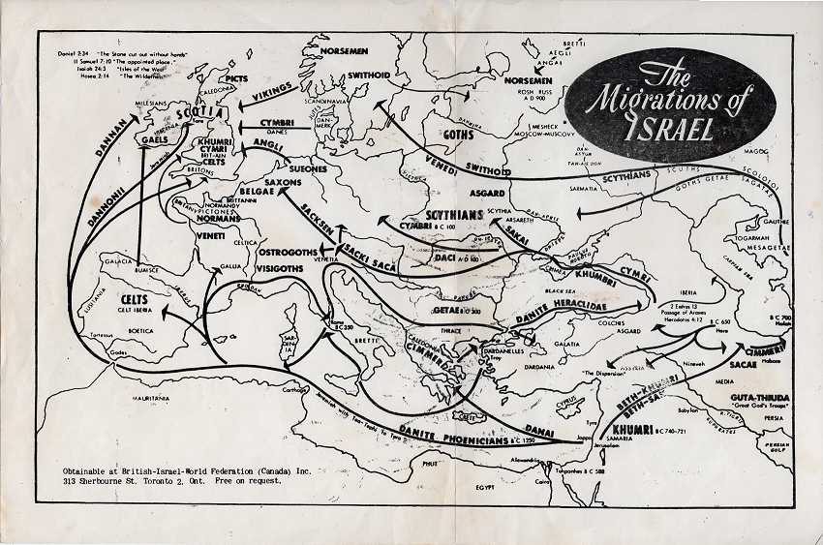

Slide 58
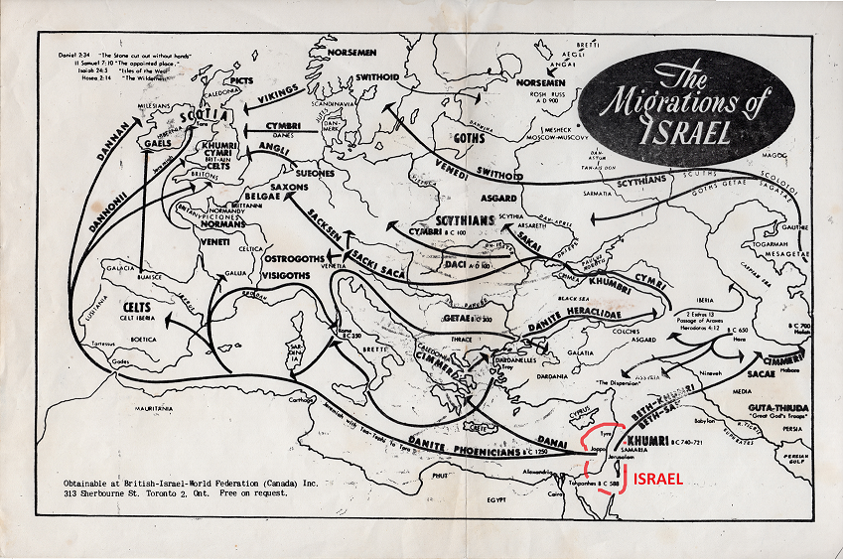

Slide 59
This next slide shows an example of the settlements of the northern tribes of israel in france during ceasar’s time

Slide 60
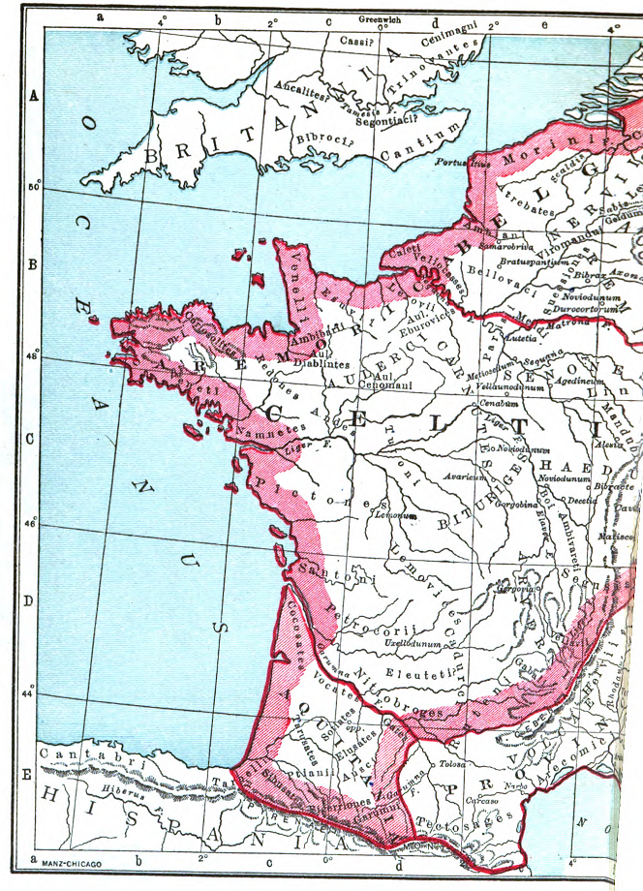
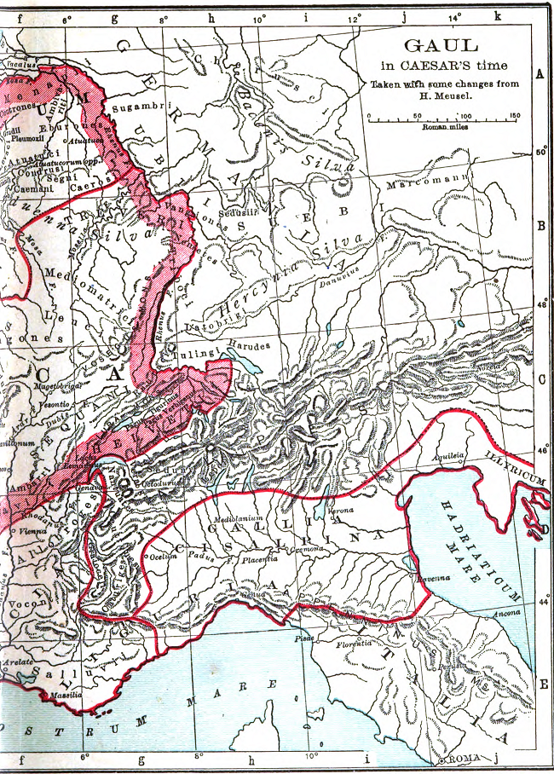

Slide 61
heritage
All of the routes ended westward in Western Europe.

Slide 62
heritage
These next slides show some of the various tribal names

Slide 63
HERITage
Gauls
Angles
Celts

Slide 64
HERITage
Gauls
Angles
Celts
GL
GL
CL
Notice the silimarities of the base letters of the tribal names

Slide 65
heritage
These next slides show a Hebrew word that would most likely relate to these tribal names

Slide 66
HERITage

Slide 67
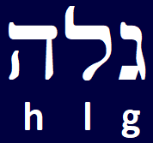
HERITage

Slide 68
HERITage
Galah = exile

Slide 69
heritage
Based on Yair Davidiy’s research, the Israelites migrated throughout the centuries in Western Europe.

Slide 70
Possible BIBLICAL ROOTS OF HALOWEEN

Slide 71
1 Kings 12:25-33

Slide 72
POSSIBLE BIBLICAL ROOTS OF HALOWEEN
1 Kings 12:25 Then Jeroboam built Shechem in the hill country of Ephraim, and lived there. And he went out from there and built Penuel. 26 Jeroboam said in his heart, "Now the kingdom will return to the house of David. 27 "If this people go up to offer sacrifices in the house of the LORD at Jerusalem, then the heart of this people will return to their lord, even to Rehoboam king of Judah; and they will kill me and return to Rehoboam king of Judah." 28 So the king consulted, and made two golden calves, and he said to them, "It is too much for you to go up to Jerusalem; behold your gods, O Israel, that brought you up from the land of Egypt."

Slide 73
Possible BIBLICAL ROOTS OF HALOWEEN
1 Kings 12:29 He set one in Bethel, and the other he put in Dan. 30 Now this thing became a sin, for the people went to worship before the one as far as Dan. 31 And he made houses on high places, and made priests from among all the people who were not of the sons of Levi. 32 Jeroboam instituted a feast in the eighth month on the fifteenth day of the month, like the feast which is in Judah, and he went up to the altar; thus he did in Bethel, sacrificing to the calves which he had made. And he stationed in Bethel the priests of the high places which he had made. 33 Then he went up to the altar which he had made in Bethel on the fifteenth day in the eighth month, even in the month which he had devised in his own heart; and he instituted a feast for the sons of Israel and went up to the altar to burn incense.

Slide 74
Possible BIBLICAL ROOTS OF HALOWEEN
Jeroboam I reigned between 933-911 BC.

Slide 75
Possible BIBLICAL ROOTS OF HALOWEEN
The approximate time that king Jeroboam I set up the two golden calves was about 925 BC.

Slide 76
SUMMARY

Slide 77
SUMMARY
A feast consist of a god/deity, a date including day and month, priests, a sacrifice and food to feast

Slide 78
SUMMARY
A feast consist of a god/deity, a date including day and month, priests, a sacrifice and food to feast
Samhain occurs between the end of October and the beginning of November

Slide 79
SUMMARY
A feast consist of a god/deity, a date including day and month, priests, a sacrifice and food to feast
Samhain occurs between the end of October and the beginning of November
Samhain is similar to the Hebrew Shemonah

Slide 80
SUMMARY
A feast consist of a god/deity, a date including day and month, priests, a sacrifice and food to feast
Samhain occurs between the end of October and the beginning of November
Samhain is similar to the Hebrew Shemonah
The Biblical calendar occurs in generic format halfway between the months

Slide 81
SUMMARY
A feast consist of a god/deity, a date including day and month, priests, a sacrifice and food to feast
Samhain occurs between the end of October and the beginning of November
Samhain is similar to the Hebrew Shemonah
The Biblical calendar occurs in generic format halfway between the months
A Chasidic Jew reveals information that the Israelites migrated westward to Western Europe

Slide 82
SUMMARY
The names of the Celts, the Gauls and the Angles show similar spelling with basic letters which is comparable to the Hebrew word Galah meaning exile

Slide 83
SUMMARY
The names of the Celts, the Gauls and the Angles show similar spelling with basic letters which is comparable to the Hebrew word Galah meaning exile
The scripture account in 1 Kings 12:25-33 show very similarities hundreds of years earlier to what the Celts and Druids did in Ireland as early as Roman times

Slide 84
FINIS

