Slide 1


Slide 2
WHEN WAS YESHUA BORN?
Evidence Based on Scriptural Facts

Slide 3
Copyright 2014/2017

Slide 4
Starting with the Commandment on circumcising a newborn son which is noted in the book of Leviticus

Slide 5
Leviticus 12:1-3

Slide 6
The commandment for a newborn son
Leviticus 12:1-3
1 And יהוהspoke to Moses, to say, 2 Speak to the Sons of Israel, to say, If a woman, she has seeded, and has birthed a male: and shall be unclean seven days; as the days of the impurity of her infirmity, she shall be unclean. 3 And on the eighth day shall circumcise the flesh of his foreskin.

Slide 7
Now, reading the record of Yeshua’s first eight days of life which is noted in the Gospel of Luke

Slide 8
Luke 1:26-38; 2:1-39

Slide 9
The Record Of Yeshua’s first eight days of life
Luke 1:26-38; 2:1-39
26 And in the sixth month [of Elizabeth's pregnancy] the messenger Gabriel was sent from יהוה unto a city of Galilee, named Nazareth, 27 To a virgin espoused to a man whose name was Joseph, of the house of David; and the virgin's name was Mary. 28 And the messenger came in unto her, and said, Hail, thou that art highly favoured, יהוהis with thee: blessed art thou among women.

Slide 10
The Record Of Yeshua’s first eight days of life
Luke 1:26-38; 2:1-39
29 And when she saw him, she was troubled at his saying, and cast in her mind what manner of salutation this should be. 30 And the messenger said unto her, Fear not, Mary: for thou hast found favour with יהוה. 31 And, behold, thou shalt conceive in thy womb, and bring forth a Son, and shalt call His Name YESHUA.

Slide 11
The Record Of Yeshua’s first eight days of life
Luke 1:26-38; 2:1-39
32 He shall be great, and shall be called the Son of the Highest [Matthew 1:23 Emmanu El]: and יהוהElohim shall give unto Him the throne of His father, David: 33 And He shall reign over the House of Jacob for ever; and of His Kingdom there shall be no end. 34 Then said Mary unto the messenger, How shall this be, seeing I know not a man?

Slide 12
The Record Of Yeshua’s first eight days of life
Luke 1:26-38; 2:1-39
35 And the messenger answered and said unto her, The Holy Spirit shall come upon thee, and the Power of the Highest shall overshadow thee: therefore also that Holy Thing which shall be born of thee shall be called the Son of Elohim. 36 And, behold, thy cousin, Elisabeth, she hath also conceived a son in her old age: and this is the sixth month with her, who was called barren.

Slide 13
The Record Of Yeshua’s first eight days of life
Luke 1:26-38; 2:1-39
37 For with יהוהnothing shall be impossible. 38 And Mary said, Behold the handmaid of יהוה; be it unto me according to thy Word. And the messenger departed from her.

Slide 14
Gabriel’s visitation with Mary occurred during the Feast of Khanukkah. This will be explained later in the teaching.

Slide 15
As inserted above in verse thirty two, he would be also called Emmanu El, which is noted from the book of the prophet Isaiah

Slide 16
The Record Of Yeshua’s first eight days of life
Luke 1:26-38; 2:1-39
Isaiah 7:10 Moreover יהוהspake again unto Ahaz, saying, 11 Ask thee a Sign of יהוה thy Elohim; ask it either in the depth, or in the height above. 12 But Ahaz said, I will not ask, neither will I tempt יהוה. 13 And he said, Hear ye now, O house of David; Is it a small thing for you to weary men, but will ye weary my Elohim also? 14 Therefore Adonai, Himself, shall give you a Sign; Behold, a virgin shall conceive, and bear a son, and shall call His Name, Immanuel.

Slide 17
Continuing:

Slide 18
The Record Of Yeshua’s first eight days of life
Luke 1:26-38; 2:1-39
2:1 And it came to pass in those days, that there went out a decree from Caesar Augustus, that all of the world should be taxed. 2 (And this taxing was first made when Cyrenius was Governor of Syria.) 3 And all went to be taxed, every one into his own city.

Slide 19
The Record Of Yeshua’s first eight days of life
Luke 1:26-38; 2:1-39
4 And Joseph also went up from Galilee, out of the city of Nazareth, into Judaea, unto the City of David, which is called Bethlehem; (because he was of the house and lineage of David:) 5 To be taxed with Mary his espoused wife, being great with Child. 6 And so it was, that, while they were there, the days were accomplished that she should be delivered.

Slide 20
The Record Of Yeshua’s first eight days of life
Luke 1:26-38; 2:1-39
7 And she brought forth her Firstborn Son, and wrapped Him in swaddling clothes, and laid Him in a manger; because there was no room for them in the inn. 8 And there were in the same country shepherds abiding in the field, keeping watch over their flock by night. 9 And, lo, the messenger of יהוהcame upon them, and the Glory of יהוה shone round about them: and they were sore afraid.

Slide 21
The Record Of Yeshua’s first eight days of life
Luke 1:26-38; 2:1-39
10 And the messenger said unto them, Fear not: for, behold, I bring you good tidings of great joy, which shall be to all people. 11 For unto you is born this day in the city of David a Saviour, which is יהוה Messiah. 12 And this shall be a Sign unto you; Ye shall find the Babe wrapped in swaddling clothes, lying in a manger.

Slide 22
The Record Of Yeshua’s first eight days of life
Luke 1:26-38; 2:1-39
13 And suddenly there was with the messenger a multitude of the heavenly host praising יהוה, and saying, 14 Glory to יהוהin the highest, and on earth peace, good will toward men.

Slide 23
The Record Of Yeshua’s first eight days of life
Luke 1:26-38; 2:1-39
15 And it came to pass, as the messengers were gone away from them into the heavens, the shepherds said one to another, Let us now go even unto Bethlehem, and see this rhema (thing, matter) which is come to pass, which יהוהhath made known unto us. 16 And they came with haste, and found Mary, and Joseph, and the Babe lying in a manger.

Slide 24
The Record Of Yeshua’s first eight days of life
Luke 1:26-38; 2:1-39
17 And when they had seen It, they made known abroad the saying which was told them concerning this Child. 18 And all they that heard it wondered at those things which were told them by the shepherds. 19 But Mary kept all of these rhemas (things, matters), and pondered them in her heart.

Slide 25
The Record Of Yeshua’s first eight days of life
Luke 1:26-38; 2:1-39
20 And the shepherds returned, glorifying and praising יהוהfor all the things that they had heard and seen, as it was told unto them. 21 And when eight days were accomplished for the circumcising of the Child, His Name was called YESHUA, which was so named of the messenger before He was conceived in the womb.

Slide 26
The Record Of Yeshua’s first eight days of life
Luke 1:26-38; 2:1-39
22 And when the days of her purification according to the Torah of Moses were accomplished, they brought him to Jerusalem, to present Him to יהוה; 23 (As it is written in the Torah of יהוה, Every male that openeth the womb shall be called Holy to יהוה;) 24 And to offer a Sacrifice according to that which is said in the Torah of יהוה, A pair of turtledoves, or two young pigeons.

Slide 27
The Record Of Yeshua’s first eight days of life
Luke 1:26-38; 2:1-39
25 And, behold, there was a man in Jerusalem, whose name was Simeon; and the same man was just and devout, waiting for the consolation of Israel: and the Holy Spirit was upon him. 26 And it was revealed unto him by the Holy Spirit, that he should not see death, before he had seen the יהוה's Messiah (Annointed).

Slide 28
The Record Of Yeshua’s first eight days of life
Luke 1:26-38; 2:1-39
27 And he came by the Spirit into the Temple: and when the parents brought in the Child, Yeshua, to do for Him after the Custom of the Torah, 28 Then took He him up in his arms, and blessed יהוה, and said, 29 יהוה, now lettest Thou Thy servant depart in peace, according to Thy Word:

Slide 29
The Record Of Yeshua’s first eight days of life
Luke 1:26-38; 2:1-39
30 For mine eyes have seen Thy Salvation, 31 Which Thou hast prepared before the face of all people; 32 A light to lighten the Gentiles, and the glory of Thy People, Israel. 33 And Joseph and His mother marvelled at those things which were spoken of him.

Slide 30
The Record Of Yeshua’s first eight days of life
Luke 1:26-38; 2:1-39
34 And Simeon blessed them, and said unto Mary, His mother, Behold, this Child is set for the fall and rising again of many in Israel; and for a Sign which shall be spoken against; 35 (Yea, a sword shall pierce through thy own soul also,) that the thoughts of many hearts may be revealed.

Slide 31
The Record Of Yeshua’s first eight days of life
Luke 1:26-38; 2:1-39
36 And there was one Anna, a prophetess, the daughter of Phanuel, of the tribe of Asher: she was of a great age, and had lived with an husband seven years from her virginity; 37 And she was a widow of about fourscore and four years, which departed not from the Temple, but served with fastings and prayers night and day.

Slide 32
The Record Of Yeshua’s first eight days of life
Luke 1:26-38; 2:1-39
38 And she coming in that instant gave thanks likewise unto יהוה, and spake of Him to all them that looked for redemption in Jerusalem. 39 And when they had performed all things according to the Torah of יהוה, they returned into Galilee, to their own city Nazareth.

Slide 33
The Commandment for a newborn male child in Luke’s passage is noted in the book of Exodus

Slide 34
The Record Of Yeshua’s first eight days of life
Luke 1:26-38; 2:1-39
Exodus 13:1 And יהוהspoke to Moses, to say, 2 Sanctify to Me all of the firstborn opening the womb among the Sons of Israel, among the Adam, and among the animals: he shall belong to Me.

Slide 35
The offering of Mary in providing the two turtledoves is noted from the book of Leviticus

Slide 36
The Record Of Yeshua’s first eight days of life
Luke 1:26-38; 2:1-39
Leviticus 12:4 And of thirty days and three days, she shall dwell in the blood of her purification; she shall not touch on any Holy Thing, and she shall not go to the Sanctuary until the days of her purification are fulfilled.... 6 And in the fulfillment of the days of her purification for a son or for a daughter, she shall bring a lamb of a son of his year for an Elevation Offering, and a son of a dove or a turtledove for a Sin Offering to the Entrance of the Tent of Appointment to the Priest:

Slide 37
The Record Of Yeshua’s first eight days of life
Luke 1:26-38; 2:1-39
7 And shall bring him to the Face of יהוה, and shall atone upon her; and shall be cleansed from the flow of her blood. This is the Teaching (Torah) of the one birthing for a male or for a female. 8 And if she cannot suffiently find of her hand a lamb, and shall take two turtledoves or two sons of doves; one for an Elevation Offering, and one for a Sin Offering: and the Priest shall atone upon her, and shall be clean.

Slide 38
Based on Luke chapter two noted above, it could be probable that Yeshua was born in the same plot of land that Boaz and David resided in their day.

Slide 39
Charting out Yeshua’s first eight days from His birth to his circumcision, it would look somewhat like this:

Slide 40
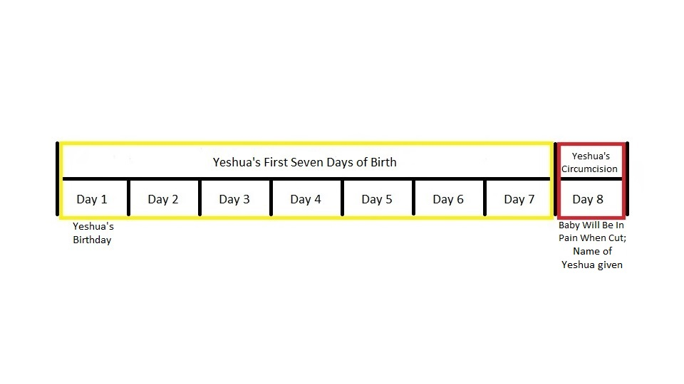

Slide 41
These next few slides is what I call “The Four Questions” in relation to this teaching:

Slide 42
FIRST QUESTION:

Slide 43
Where is the source that would show the most appropriate time for Yeshua to be born?

Slide 44
ANSWER:

Slide 45
The best answer would be the Torah, for Yeshua said this, which is noted in the Gospel of John

Slide 46
John 5:46 For had ye believed Moses, ye would have believed me: for he wrote of Me.

Slide 47
SECOND QUESTION:

Slide 48
What event in the Torah would Yeshua have to come into the world?

Slide 49
ANSWER:

Slide 50
The Biblical High Holy Days!

Slide 51
It would be impossible for Yeshua to be born in any other major event but one of the High Holy Days.

Slide 52
THIRD QUESTION:

Slide 53
What kind of High Holy Day period would Yeshua had to have been born?

Slide 54
ANSWER:

Slide 55
An eight day Biblical High Holy Day period.

Slide 56
FOURTH QUESTION:

Slide 57
Are there any Biblical High Holy Days that have eight day periods?

Slide 58
ANSWER:

Slide 59
Only two series of High Holy Days have eight day events:

Slide 60
ONLY TWO SERIES OF HIGH HOLY DAYS HAVE EIGHT DAY EVENTS
Passover and the Feast of Unleavened Bread

Slide 61
ONLY TWO SERIES OF HIGH HOLY DAYS HAVE EIGHT DAY EVENTS
Passover and the Feast of Unleavened Bread
The Feast of Sukkoth and the Solemn Assembly

Slide 62
The reason I say this, because in my humble but strong opinion, Yeshua, the Son of Elohim, who is יהוה, would not be born on any man’s pagan calendar, like the western Gregorian Calendar, in which the Gregorian New Year starts on January 1st.

Slide 63
Also, Yeshua would not be born on any of the man made pagan holidays, like Christmas, which according to Michael Rood of A Rood Awakening is based on the pagan Babylonian holiday of the birth of Tammuz on December 25th.

Slide 64
Yeshua would have had to be born on His Father's Biblical Calendar, which is also Yeshua's Calendar, because He is the Living Word made Flesh, which includes the Word of the Calendar of יהוה in the Torah, which is noted in the Gospel of John above

Slide 65
This would include the High Holy Days of יהוה, which are the Seven Appointed Times of יהוה.

Slide 66
PASSOVER AND THE FEAST OF UNLEAVENED BREAD

Slide 67
This Spring High Holy Day feast has an eight day period including one day of Passover and the seven days of the Feast of Unleavened Bread.

Slide 68
Some say that Yeshua was born during Passover and the Feast of Unleavened Bread.

Slide 69
This is the account of this eight day Spring feast period, which is noted in the books of Exodus and Leviticus

Slide 70
Exodus 12:3, 6; 13:6

Slide 71
The one day of Passover and the seven days of the Feast of Unleavened Bread
Exodus 12:3, 6; 13:6
12:3 Speak to all of the Congregation of Israel, to say, On the tenth of this month, and they shall take each for themselves a lamb for the house of their fathers, a lamb for the house:... 6 And shall be for you to keep until the fourteenth day of this month: and all of the Assembly of the Congregation of Israel shall kill him between the mixing periods (evenings).... 13:6 Seven days you shall eat unleavened bread, and on the seventh shall be a Feast to יהוה.

Slide 72
Leviticus 23:5-8

Slide 73
The one day of Passover and the seven days of the Feast of Unleavened Bread
Leviticus 23:5-8
5 In the first month, on the fourteenth of the month, between the mixing periods (evenings), is the Passover to יהוה. 6 And on the fifteenth day of this month is the Feast of the Unleavened Bread to יהוה: seven days of unleavened bread you shall eat. 7 On the first day shall be to you of a Holy Calling: you shall not do any work of service. 8 And you shall bring near a Fire Offering to יהוהseven days: on the seventh day shall be a Holy Calling: you shall not do any work of service.

Slide 74
The following slides will show comparisons between Yeshua’s first eight days of life and between the one day of Passover and the seven days of the Feast of Unleavened Bread:

Slide 75
THE Comparison BETWEEN yeshua’s First Eight days of life AND BETWEEN the one day of Passover and the seven days of the feast of unleavened bread
Yeshua’s Life: 1st day
Birth of a baby

Slide 76
THE Comparison BETWEEN yeshua’s First Eight days of life AND BETWEEN the one day of Passover and the seven days of the feast of unleavened bread
Yeshua’s Life: 1st day
Passover: 1st day
Birth of a baby
Death of a lamb

Slide 77
THE Comparison BETWEEN yeshua’s First Eight days of life AND BETWEEN the one day of Passover and the seven days of the feast of unleavened bread
Yeshua’s Life: 1st day
Passover: 1st day
Birth of a baby
Death of a lamb
These two days are opposite of each other, because one is the beginning of life. The other is death.

Slide 78
THE Comparison BETWEEN yeshua’s First Eight days of life AND BETWEEN the one day of Passover and the seven days of the feast of unleavened bread
Yeshua’s Life: 2nd day
Regular day

Slide 79
THE Comparison BETWEEN yeshua’s First Eight days of life AND BETWEEN the one day of Passover and the seven days of the feast of unleavened bread
Yeshua’s Life: 2nd day
Unleavened Bread: 1st day
Regular day
No service work

Slide 80
THE Comparison BETWEEN yeshua’s First Eight days of life AND BETWEEN the one day of Passover and the seven days of the feast of unleavened bread
Yeshua’s Life: 2nd day
Unleavened Bread: 1st day
Regular day
No service work
They are dissimilar. Day ordinals not in harmony.

Slide 81
THE Comparison BETWEEN yeshua’s First Eight days of life AND BETWEEN the one day of Passover and the seven days of the feast of unleavened bread
Yeshua’s Life: 8th day
Circumcision day
Baby in pain from cut

Slide 82
THE Comparison BETWEEN yeshua’s First Eight days of life AND BETWEEN the one day of Passover and the seven days of the feast of unleavened bread
Yeshua’s Life: 8th day
Unleavened Bread: 7th day
Circumcision day
Baby in pain from cut
No service work
Public feast day

Slide 83
THE Comparison BETWEEN yeshua’s First Eight days of life AND BETWEEN the one day of Passover and the seven days of the feast of unleavened bread
Yeshua’s Life: 8th day
Unleavened Bread: 7th day
Circumcision day
Baby in pain from cut
No service work
Public feast day
Some similarities, but the day ordinals are not in harmony.

Slide 84
The following is a chart of the one day of Passover and the seven days of the Feast of Unleavened Bread

Slide 85
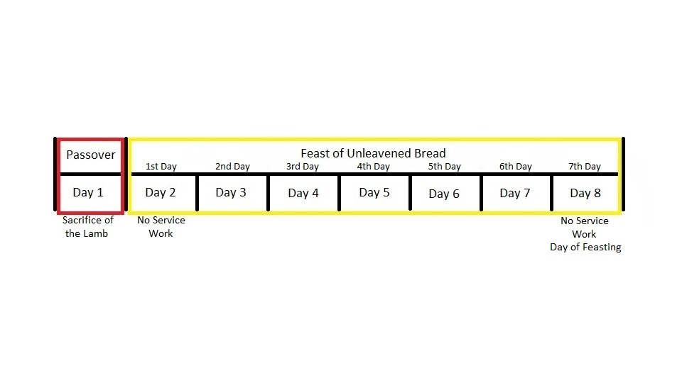

Slide 86
This next chart shows the comparison between the one day of Passover and the seven days of the Feast of Unleavened Bread, and between the first eight days of Yeshua’s life

Slide 87
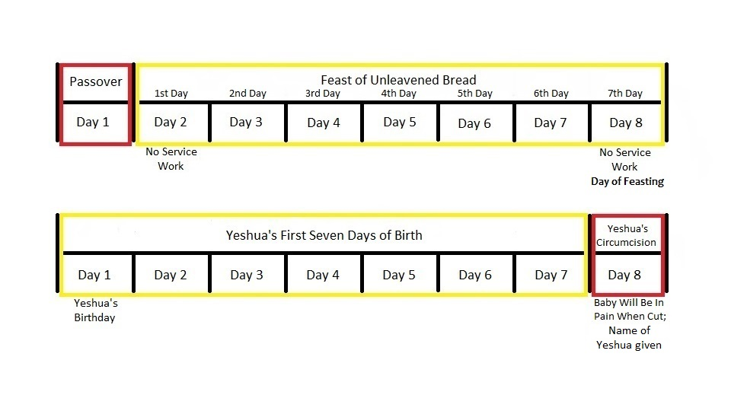

Slide 88
CONCLUSION

Slide 89
THE Comparison BETWEEN yeshua’s First Eight days of life AND BETWEEN the one day of Passover and the seven days of the feast of unleavened bread
There are dissimilarities between the first eight days of Yeshua’s life and between the one day of Passover and the seven days of the Feast of Unleavened Bread. Passover and the Feast of Unleavened bread also relates to death, sacrifice and sin. It is most likely that Yeshua was not born in the Spring High Holy Days.

Slide 90
THE FALL FEAST OF THE SEVEN DAYS OF SUKKOTH AND THE ONE DAY OF THE SOLEMN ASSEMBLY

Slide 91
This is the Torah Commandment of Sukkoth and the Solemn Assembly, which is noted in the book of Leviticus

Slide 92
Leviticus 23:34-36, 39

Slide 93
The SEVEN days of the FEAST OF SUKKOTH, AND the one day of THE SOLEMN ASSEMBLY
Leviticus 23:34-36, 39
34 Speak to the Sons of Israel, to say, On the fifteenth day of this seventh month shall be the Feast of the Booths of seven days to יהוה. 35 On the first day shall be a Holy Calling: you shall not do any work of service.

Slide 94
The SEVEN days of the FEAST OF SUKKOTH, AND the one day of THE SOLEMN ASSEMBLY
Leviticus 23:34-36, 39
36 Seven days you shall bring a Fire Offering to יהוה: on the eighth day shall be a Holy Calling to yourselves; and you shall bring near a Fire Offering to יהוה: she is a Solemn Assembly; you shall not do any work of service....

Slide 95
The SEVEN days of the FEAST OF SUKKOTH, AND the one day of THE SOLEMN ASSEMBLY
Leviticus 23:34-36, 39
39 Only on the fifteenth day of the seventh month in your gathering את-the produce of the land, you shall celebrate את-the Feast of יהוה seven days: on the first day shall be a Rest, and on the eighth day shall be a Rest.

Slide 96
The following slides will show comparisons between Yeshua’s first eight days of life and between the seven days of Sukkoth and the one day of the Solemn Assembly:

Slide 97
The Comparison Between yeshua’s first eight days of life and between The SEVEN days of the FEAST OF SUKKOTH, AND the one day of THE SOLEMN ASSEMBLY
Yeshua’s Life: 1st day
Birth of a baby

Slide 98
The Comparison Between yeshua’s first eight days of life and between The SEVEN days of the FEAST OF SUKKOTH, AND the one day of THE SOLEMN ASSEMBLY
Yeshua’s Life: 1st day
Sukkoth: 1st day
Birth of a baby
Holy Calling
No service work
High Shabbath

Slide 99
The Comparison Between yeshua’s first eight days of life and between The SEVEN days of the FEAST OF SUKKOTH, AND the one day of THE SOLEMN ASSEMBLY
Yeshua’s Life: 1st day
Sukkoth: 1st day
Birth of a baby
Holy Calling
No service work
High Shabbath
Both of these two accounts show special events on this day.

Slide 100
The Comparison Between yeshua’s first eight days of life and between The SEVEN days of the FEAST OF SUKKOTH, AND the one day of THE SOLEMN ASSEMBLY
Yeshua’s Life: 2nd-7th days
Regular days
Still celebrating birth
Baby not yet named

Slide 101
The Comparison Between yeshua’s first eight days of life and between The SEVEN days of the FEAST OF SUKKOTH, AND the one day of THE SOLEMN ASSEMBLY
Yeshua’s Life: 2nd-7th days
Sukkoth: 2nd-7th days
Regular days
Still celebrating birth
Baby not yet named
Regular days
Still celebrating

Slide 102
The Comparison Between yeshua’s first eight days of life and between The SEVEN days of the FEAST OF SUKKOTH, AND the one day of THE SOLEMN ASSEMBLY
Yeshua’s Life: 2nd-7th days
Sukkoth: 2nd-7th days
Regular days
Still celebrating birth
Baby not yet named
Regular days
Still celebrating
They are both similar to each other showing no changes for these six days.

Slide 103
The Comparison Between yeshua’s first eight days of life and between The SEVEN days of the FEAST OF SUKKOTH, AND the one day of THE SOLEMN ASSEMBLY
Yeshua’s Life: 8th day
Circumcision
Baby in pain from cut
Baby named

Slide 104
The Comparison Between yeshua’s first eight days of life and between The SEVEN days of the FEAST OF SUKKOTH, AND the one day of THE SOLEMN ASSEMBLY
Yeshua’s Life: 8th day
Solemn Assembly: 8th day
Circumcision
Baby in pain from cut
Baby named
Holy Calling
No service work
High Shabbath

Slide 105
The Comparison Between yeshua’s first eight days of life and between The SEVEN days of the FEAST OF SUKKOTH, AND the one day of THE SOLEMN ASSEMBLY
Yeshua’s Life: 8th day
Solemn Assembly: 8th day
Circumcision
Baby in pain from cut
Baby named
Holy Calling
No service work
High Shabbath
Both show solemn events on the same day.

Slide 106
This is a chart showing the seven days of Sukkoth including the one day of the Solemn Assembly

Slide 107
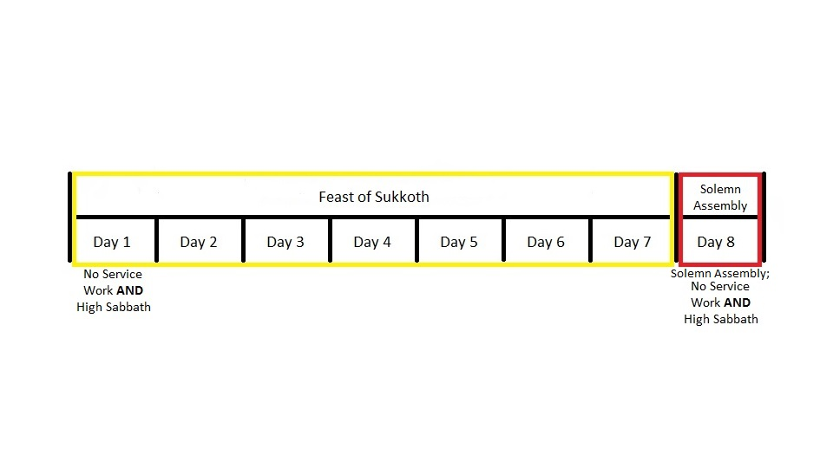

Slide 108
This next chart shows the comparison between the seven days of Sukkoth and the one day of the Solemn Assembly, and between Yeshua’s first eight days of life

Slide 109
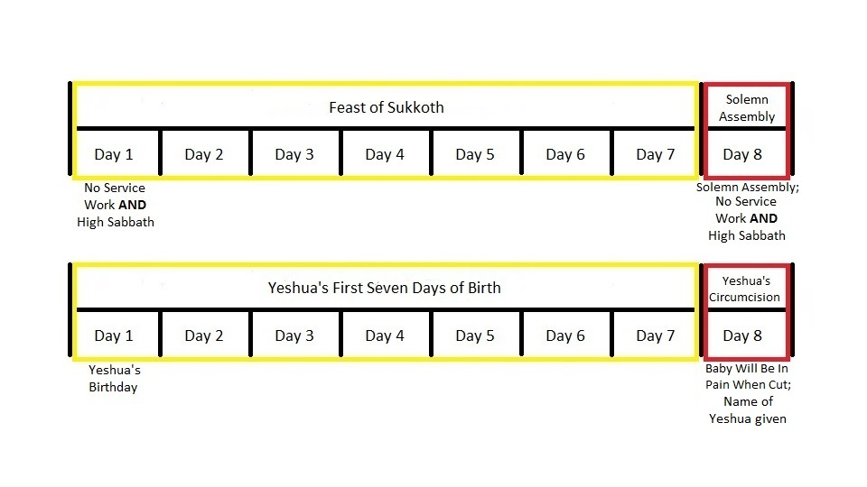

Slide 110
CONCLUSION

Slide 111
The Comparison Between yeshua’s first eight days of life and between The SEVEN days of the FEAST OF SUKKOTH, AND the one day of THE SOLEMN ASSEMBLY
This gives a strong comparison that Yeshua would have been born on the seven days of Sukkoth and the one day of the Solemn Assembly.

Slide 112
SUKKOTH

Slide 113
This is the definition of Sukkoth:

Slide 114
“SUKKOTH”
Strong’s Concordance H5521
סֻכָּה
sûkkâh
sook-kah'
Feminine of H5520; a hut or lair: - booth, cottage, covert, pavilion, tabernacle, tent.

Slide 115
“SUKKOTH”
Strong’s Concordance H5520
סֹךְ
sôk
sokhe
From H5526; a hut (as of entwined boughs); also a lair: - covert, den, pavilion, tabernacle.

Slide 116
“SUKKOTH”
Strong’s Concordance H5526
שָׂכַךְ סָכַךְ
sâkak śâkak
sah-khakh‘, sah-khakh'
A primitive root; properly to entwine as a screen; by implication to fence in, cover over, (figuratively) protect: - cover, defence, defend, hedge in, join together, set, shut up.

Slide 117
SOURCES

Slide 118
There are the Scriptures to give credibility to the premise that Yeshua was born on Sukkoth:

Slide 119
SOURCE NUMBER ONE:

Slide 120
Genesis 17:1-17, 19, 21-24

Slide 121
THE FIRST SUKKOTH ACCOUNT

Slide 122
PART ONE

Slide 123
THERE ARE SCRIPTURES TO GIVE Credibility TO THIS PREMISE that yeshua was born on sukkoth
Source #1: Genesis 17:1-17, 19, 21-24
1 And Abram was a son of ninety years and nine years, and יהוה appeared to Abram, and said to him, I am El Shaddai; walk toward My Face, and be perfect, 2 and I will make My Covenant between Me and and between you, and I will multiply you in much, much. 3 And Abram fell upon his face: and Elohim spoke to him, to say, 4 Behold I, My Covenant is with you, and you shall be for a father of many nations,

Slide 124
THERE ARE SCRIPTURES TO GIVE Credibility TO THIS PREMISE that yeshua was born on sukkoth
Source #1: Genesis 17:1-17, 19, 21-24
5 and shall not be called any moreאת -your name Abram, and your name shall be Abraham; for I have made you a father of many nations. 6 And I will fructify you in much, much, and I will give for you nations, and kings shall come from you. 7 And I will establishאת -My Covenant between Me and between you, and between your seed after you to their generations for a Covenant of Ages, to be to you for Elohim, and to your seed after you.

Slide 125
THERE ARE SCRIPTURES TO GIVE Credibility TO THIS PREMISE that yeshua was born on sukkoth
Source #1: Genesis 17:1-17, 19, 21-24
8 And I will give to you and to your seed after you אתthe land of your sojourning, אתall the land of Canaan, for an Inhertance of Ages; and I will be to them for Elohim. 9 And Elohim said to Abraham, And you, you shall keep את-My Covenant, you, and your seed after you to their generations. 10 This is My Covenant which you shall keep between Me, and between you, and between your seed after you; Circumcise to yourselves every male.

Slide 126
THERE ARE SCRIPTURES TO GIVE Credibility TO THIS PREMISE that yeshua was born on sukkoth
Source #1: Genesis 17:1-17, 19, 21-24
11 And you shall circumciseאת -the flesh of your foreskins; and shall be for a Token of the Covenant between Me and between you. 12 And a son of eight days shall be circumcised to you of every male to your generations that is birthed in the house, or bought with silver from any son of a foreigner whom he is not of your seed. 13 That circumcising, shall be circumcised one birthed of your house, and one bought from your silver: and My Covenant, she shall be in your flesh for a Covenant of Ages.

Slide 127
THERE ARE SCRIPTURES TO GIVE Credibility TO THIS PREMISE that yeshua was born on sukkoth
Source #1: Genesis 17:1-17, 19, 21-24
14 And an uncircumcised male who has not circumcisedאת -the flesh of his foreskin is not circumcised, and shall cut her off, she, the soul, from her People; has brokenאת -My Covenant. 15 And Elohim said to Abraham, Sarai is your wife, you shall not callאת -her name Sarai, for Sarah shall be her name. 16 And I have blessed her, and I have also given her a son to you: and will bless her, and she shall be for nations; kings of peoples shall be from her.

Slide 128
THERE ARE SCRIPTURES TO GIVE Credibility TO THIS PREMISE that yeshua was born on sukkoth
Source #1: Genesis 17:1-17, 19, 21-24
17 And Abraham fell upon his face, and laughed, and said in his heart, That of a son of a hundred years shall birth? And also Sarah, the daughter of ninety years, she shall birth?... 19 And Elohim said, Sarah, your wife, shall birth to you a son; and you shall callאת -his name Isaac: and I will establishאת -My Covenant with him for a Covenant of Ages, and to his seed after him.... 21 And את-My Covenant will I establish withאת -Isaac whom Sarah, she shall birth to you by this appointed time in the next year. 22 And finished to speak with him, and Elohim ascended upon Abraham.

Slide 129
THERE ARE SCRIPTURES TO GIVE Credibility TO THIS PREMISE that yeshua was born on sukkoth
Source #1: Genesis 17:1-17, 19, 21-24
23 And Abraham tookאת -Ishmael his son, and אתall the ones birthed of his house, andאת -all bought with his silver, every male among the men of the house of Abraham; and circumcised the flesh of their foreskins in this same day as which Elohim spoke to him. 24 And Abraham was a son of ninety years and nine years in his circumcising the flesh of his foreskin.

Slide 130
THERE ARE SCRIPTURES TO GIVE Credibility TO THIS PREMISE that yeshua was born on sukkoth
Source #1: Genesis 17:1-17, 19, 21-24
It is most probable that this “appointed time” in verse twenty-one took place on the first day of Sukkoth.

Slide 131
Looking at the summary of this source:

Slide 132
THERE ARE SCRIPTURES TO GIVE Credibility TO THIS PREMISE that yeshua was born on sukkoth
Abram and Sarai’s names were changed to Abraham
and Sarah.

Slide 133
THERE ARE SCRIPTURES TO GIVE Credibility TO THIS PREMISE that yeshua was born on sukkoth
Abram and Sarai’s names were changed to Abraham
and Sarah.
“Abraham laughed”.

Slide 134
THERE ARE SCRIPTURES TO GIVE Credibility TO THIS PREMISE that yeshua was born on sukkoth
Abram and Sarai’s names were changed to Abraham
and Sarah.
“Abraham laughed”.
The baby that will be born one year later is named Isaac.

Slide 135
THERE ARE SCRIPTURES TO GIVE Credibility TO THIS PREMISE that yeshua was born on sukkoth
All the males in Abraham’s household were
circumcised.

Slide 136
THERE ARE SCRIPTURES TO GIVE Credibility TO THIS PREMISE that yeshua was born on sukkoth
All the males in Abraham’s household were
circumcised.
The promise of Isaac did not occur until after Abraham and Sarah’s names were changed.

Slide 137
This is the definition of Laughed:

Slide 138
“LAUGHED”
Strong’s Concordance number H6711
צָחַק
tsâchaq
tsah-khak'
A primitive root; to laugh outright (in merriment or scorn); by implication to sport: - laugh, mock, play, make sport.

Slide 139
This is the definition of Isaac:

Slide 140
“ISAAC”
Strongs Concordance number H3327
יִצְחָק
yitschâq
yeets-khahk'
From H6711; laughter (that is, mockery); Jitschak (or Isaac), son of Abraham: - Isaac. Compare H3446.

Slide 141
THERE ARE SCRIPTURES TO GIVE Credibility TO THIS PREMISE that yeshua was born on sukkoth
Source #1: Genesis 17:1-17, 19, 21-24
It was most probable based on the time line that Abraham and all of the males under his household were circumcised on the day of Yom Kippur, the day to afflict your souls (in Abraham’s case, their foreskins). This would have given Abraham time to recuperate for hwhy and the men’s visitation on the day of Sukkoth.

Slide 142
SOURCE NUMBER TWO:

Slide 143
Genesis 18:1-16

Slide 144
THE FIRST SUKKOTH ACCOUNT

Slide 145
PART TWO

Slide 146
THERE ARE SCRIPTURES TO GIVE Credibility TO THIS PREMISE that yeshua was born on sukkoth
Source #2: Genesis 18:1-16
1 And יהוהappeared unto him in the Oaks of Mamre: and he was sitting at the entrance of the tent according to the heat of the day; 2 and lifted his eyes, and looked, and behold, three men were standing by him: and saw, and ran to meet Them from the entrance of the tent, and he bowed to the earth, 3 And said, Adonai, if now I have found favor in Your Eyes, do you not now pass over upon Your servant: 4 Take now a little water, and wash Your feet, and stay under the tree:

Slide 147
THERE ARE SCRIPTURES TO GIVE Credibility TO THIS PREMISE that yeshua was born on sukkoth
Source #2: Genesis 18:1-16
5 and I will fetch a morsel of bread, and refresh Your Hearts; afterward, You may pass over: for upon thus are You passing over upon Your servant. And They said, So you shall do as which you have said. 6 And Abraham hastened to the tent towards Sarah, and said, Haste! Three measures of fine flour, knead, and make cakes! 7 And Abraham ran to the herd, and fetched a tender and good son of a herd, and gave to the young man; and hastened to prepare him. 8 And he took butter, and milk, and a son of the herd that was prepared, and set to Their Faces; and he stood by Them under the tree, and They ate.

Slide 148
THERE ARE SCRIPTURES TO GIVE Credibility TO THIS PREMISE that yeshua was born on sukkoth
Source #2: Genesis 18:1-16
9 And They said to him, Where is Sarah your wife? And said, Behold, is in the tent. 10 And said, Returning, I will return to you according to the time of life; and behold, a son shall be to Sarah, your wife. And Sarah was listening at the entrance of the tent, and he was behind him. 11 And Abraham and Sarah were old, going in days; had ceased to be to Sarah the manner according of women. 12 And Sarah, she laughed in her midst, to say, After my failure, shall be to me pleasure, and my lord is old?

Slide 149
THERE ARE SCRIPTURES TO GIVE Credibility TO THIS PREMISE that yeshua was born on sukkoth
Source #2: Genesis 18:1-16
13 And יהוהsaid to Abraham, To why this did Sarah laugh, to say, That indeed, truly, shall I birth, and I, I am old? 14 Is a Word too hard from יהוה? I will return to you by the appointed time according to the time of life, and to Sarah shall be a son. 15 And Sarah, she denied, to say, I did not laugh; for she was afraid. And said, No; but you did laugh. 16 And the Men arose from there, and gazed upon the face of Sodom: and Abraham went with Them to send Them away.

Slide 150
THERE ARE SCRIPTURES TO GIVE Credibility TO THIS PREMISE that yeshua was born on sukkoth
Source #2: Genesis 18:1-16
In many words, Abraham was saying toיהוה : “Dwell (Sukkoth) with me”.

Slide 151
THERE ARE SCRIPTURES TO GIVE Credibility TO THIS PREMISE that yeshua was born on sukkoth
Source #2: Genesis 18:1-16
This was the first time יהוה had Sukkoth with His People, in specific, Abraham and his household.

Slide 152
There were elements for the sukkah during יהוה’s visitation to Abraham and Sarah:

Slide 153
THERE ARE SCRIPTURES TO GIVE Credibility TO THIS PREMISE that yeshua was born on sukkoth
There were guests (In Yiddish “Ushpizin”).

Slide 154
THERE ARE SCRIPTURES TO GIVE Credibility TO THIS PREMISE that yeshua was born on sukkoth
There were guests (In Yiddish “Ushpizin”).
Their shaded tree was their sukkah.

Slide 155
THERE ARE SCRIPTURES TO GIVE Credibility TO THIS PREMISE that yeshua was born on sukkoth
There were guests (In Yiddish “Ushpizin”).
Their shaded tree was their sukkah.
They were feasting outside.

Slide 156
SOURCE NUMBER THREE:

Slide 157
Genesis 21:1-7

Slide 158
THE SECOND SUKKOTH ACCOUNT

Slide 159
PART THREE

Slide 160
THERE ARE SCRIPTURES TO GIVE Credibility TO THIS PREMISE that yeshua was born on sukkoth
Source #3: Genesis 21:1-7
1 And יהוהvisitedאת -Sarah as which had said, and יהוהdid to Sarah as which was spoken. 2 And Sarah, she conceived, and she birthed to Abraham a son to his old age to the appointed time which Elohim spoke with him. 3 And Abraham calledאת -the name of his son that was birthed to him, whom Sarah birthed to him, Isaac.

Slide 161
THERE ARE SCRIPTURES TO GIVE Credibility TO THIS PREMISE that yeshua was born on sukkoth
Source #3: Genesis 21:1-7
4 And Abraham circumcisedאת -Isaac, his son, a son of eight days, as which Elohim commanded him. 5 And Abraham was a son of a hundred years in the birthing to himאת -Isaac, his son. 6 And Sarah, she said, Elohim has made laughter to me. All the ones hearing will laugh for me. 7 And she said, Who would have uttered to Abraham that Sarah would suckle sons? For I have birthed a son to his old age.

Slide 162
THERE ARE SCRIPTURES TO GIVE Credibility TO THIS PREMISE that yeshua was born on sukkoth
Source #3: Genesis 21:1-7
One can see that Abraham’s laughed (ויצחק) back in Genesis chapter seventeen was a prophetic fulfillment of joy and merriment (being merry) for the first seven days in Genesis chapter twenty-one, and his circumcision was an act of a solemn assembly on the eighth day.

Slide 163
THERE ARE SCRIPTURES TO GIVE Credibility TO THIS PREMISE that yeshua was born on sukkoth
Source #3: Genesis 21:1-7
It was most probable that there were no other males born on the first day of Sukkoth and were circumcised on the eighth day of the Solemn Assembly but Isaac. It was also probable that Isaac was the first male child to be circumcised on the actual first eight days of a male’s birth.

Slide 164
THERE ARE SCRIPTURES TO GIVE Credibility TO THIS PREMISE that yeshua was born on sukkoth
Source #3: Genesis 21:1-7
This was the second time that יהוה had Sukkoth with His People, especially His visitation to Sarah, because Sarah was the matriarch of His People.

Slide 165
THERE ARE SCRIPTURES TO GIVE Credibility TO THIS PREMISE that yeshua was born on sukkoth
Source #3: Genesis 21:1-7
One can see that Isaac’s birth was a type and shadow of Yeshua’s birth.

Slide 166
There are parallels between Isaacs birth and Yeshua’s birth:

Slide 167
There are parallels between Isaac’s birth and Yeshua’s birth
Both women had yet to bear children.

Slide 168
There are parallels between Isaac’s birth and Yeshua’s birth
Both women had yet to bear children.
Both of their parents were visited by divine visitation.

Slide 169
There are parallels between Isaac’s birth and Yeshua’s birth
Both women had yet to bear children.
Both of their parents were visited by divine visitation.
Both were born on the first day of Sukkoth.

Slide 170
There are parallels between Isaac’s birth and Yeshua’s birth
Both women had yet to bear children.
Both of their parents were visited by divine visitation.
Both were born on the first day of Sukkoth.
Both babies were named in advance.

Slide 171
There are parallels between Isaac’s birth and Yeshua’s birth
Both women had yet to bear children.
Both of their parents were visited by divine visitation.
Both were born on the first day of Sukkoth.
Both babies were named in advance.
Both were miracle babies.

Slide 172
There are parallels between Isaac’s birth and Yeshua’s birth
Both women had yet to bear children.
Both of their parents were visited by divine visitation.
Both were born on the first day of Sukkoth.
Both babies were named in advance.
Both were miracle babies.
Both were circumcised on the eighth day of the day of the Solemn Assembly.

Slide 173
ARGUMENTIVE ISSUE

Slide 174
There are those that say that Isaac was born during Passover. There are reasons that Isaac was not born on Passover:

Slide 175
there ARE REASONS THAT ISAAC WAS NOT BORN ON PASSOVER
Abraham and Sarah were not enslaved to the inhabitants of the land of Canaan.

Slide 176
there ARE REASONS THAT ISAAC WAS NOT BORN ON PASSOVER
Abraham and Sarah were not enslaved to the inhabitants of the land of Canaan.
Abraham and Sarah were not fleeing from the land of Canaan, but to inherit it for their son, Isaac, and their descendants, after their grandson, Jacob.

Slide 177
there ARE REASONS THAT ISAAC WAS NOT BORN ON PASSOVER
Abraham and Sarah were not enslaved to the inhabitants of the land of Canaan.
Abraham and Sarah were not fleeing from the land of Canaan, but to inherit it for their son, Isaac, and their descendants, after their grandson, Jacob.
Abraham and Sarah were rejoicing in having a child in the land they were to inherit for themselves and for their descendants.

Slide 178
there ARE REASONS THAT ISAAC WAS NOT BORN ON PASSOVER
Abraham and Sarah were not enslaved to the inhabitants of the land of Canaan.
Abraham and Sarah were not fleeing from the land of Canaan, but to inherit it for their son, Isaac, and their descendants, after their grandson, Jacob.
Abraham and Sarah were rejoicing in having a child in the land they were to inherit for themselves and for their descendants.
The land of Canaan was not in judgment to be destroyed like Sodom and Gomorrah.

Slide 179
there ARE REASONS THAT ISAAC WAS NOT BORN ON PASSOVER
Source #3: Genesis 21:1-7
There is something about this source passage that it does show, and it is called “Harmonic Overtones". Stepping aside from this teaching for a minute, in musical instrumental terms, harmonic overtones are other harmonic note sounds, not actually played, that occurs at the same time above the one note that is actually played. A great example of this is a typical church bell. When the bell is struck, one can hear another pitch above the natural note of the bell. One of my music faculty members at the time called the bell's overtone a "chip tone", which in music technicality in what he noted is a high pitched fourth ordinal of the musical eight note octave.

Slide 180
there ARE REASONS THAT ISAAC WAS NOT BORN ON PASSOVER
Source #3: Genesis 21:1-7
This "Harmonic Overtones Theory" analogy is not new in the Scriptures. Indirectly back to the teaching, יהוה met Abraham and Sarah with the two other men on Sukkoth (Feast of Tabernacles). But later in the previous Abrahamic account, one of the food items that Abraham gave them was "unleavened bread".

Slide 181
there ARE REASONS THAT ISAAC WAS NOT BORN ON PASSOVER
Source #3: Genesis 21:1-7
Also later in that same passage, but not noted, יהוה and the men made "haste" to go to Sodom and Gomorrah, and made Lot and his family leave Sodom and Gomorrah in "haste", which are types of the Passover- the "harmonic overtones" of this Sukkoth account. Another example is in the Gospel accounts where Yeshua and Barabbas- the symbolic "kids of the goats", with the Jewish People being the symbolic "lot stones", are "harmonic overtones" of Yom Kippur, but occurred during the time of Passover.

Slide 182
SOURCE NUMBER FOUR:

Slide 183
Genesis 24:1-67

Slide 184
THE THIRD SUKKOTH ACCOUNT

Slide 185
THERE ARE SCRIPTURES TO GIVE Credibility TO THIS PREMISE that yeshua was born on sukkoth
Source #4: Genesis 24:1-67
1 And Abraham was old, going in the days: and יהוהhad blessedאת -Abraham in allness. 2 And Abraham said to his servant, the elder of his house that ruled over all that he had, Put now your hand under my testicles: 3 And I will make you swear in יהוה, the Elohim of the Heavens, and the Elohim of the Earth, that you will not take a wife to my son from the daughters of the Canaanites whom I dwell in his midst:

Slide 186
THERE ARE SCRIPTURES TO GIVE Credibility TO THIS PREMISE that yeshua was born on sukkoth
Source #4: Genesis 24:1-67
4 But you will go to my land, and to my kindred, and you will take a wife for my son, for Isaac. 5 And the servant said to him, Perhaps the woman, she is not willing to go after me to this land: that returning, I shall returnאת -your son to the land which you came out from there? 6 And Abraham said to him, Take heed for yourself lest you returnאת -my son there.

Slide 187
THERE ARE SCRIPTURES TO GIVE Credibility TO THIS PREMISE that yeshua was born on sukkoth
Source #4: Genesis 24:1-67
7 יהוה, Elohim of the Heavens, who took me from the house of my father, and from the land of my kindred, and who spoke to me, and who swore to me, to say, I will giveאת -this land to your seed; He shall send His Messenger to your face, and you shall take a wife for my son from there. 8 And the woman, if she shall not be willing to go after you, and you shall be innocent of my oath from this: only do you not returnאת -my son there. 9 And the servant putאת -his hand under the testacles of Abraham, his master, and swore to him upon this word.

Slide 188
THERE ARE SCRIPTURES TO GIVE Credibility TO THIS PREMISE that yeshua was born on sukkoth
Source #4: Genesis 24:1-67
10 And the servant took ten camels from the camels of his master, and left; and all the goods of his master were in his hand: and arose, and went to Aram Naharaim, to the city of Nahor. 11 And the camels knelt down outside of the city to a bored-well of the water, of the time of the mixing period (evening), of the time of the going out of the drawing. 12 And said, יהוה, Elohim of my master, Abraham, cause to meet now towards the facing of today, and do kindness unto my master, Abraham. 13 Behold, I am standing by the eye-well of the water; and the daughters of the men of the city are coming out to draw water:

Slide 189
THERE ARE SCRIPTURES TO GIVE Credibility TO THIS PREMISE that yeshua was born on sukkoth
Source #4: Genesis 24:1-67
14 And shall be, the young woman whom I shall say to her, Let down now your pitcher, and I may drink her; and say of her, Drink, and also I will water your camels: her, you have designed for your servant Isaac; and in her shall I know that you have done kindness unto my master. 15 And before he finished to speak, and behold, Rebekah came out, who was birthed to Bethuel, son of Milcah, wife of Nahor, brother of Abraham, and her pitcher was upon her shoulder. 16 And the young woman was much good of form, a virgin, and a man had not known her: and she went down to the eye-well, and she filled her pitcher, and she ascended.

Slide 190
THERE ARE SCRIPTURES TO GIVE Credibility TO THIS PREMISE that yeshua was born on sukkoth
Source #4: Genesis 24:1-67
17 And the servant ran to meet her, and said, I shall drink now a little water from your pitcher. 18 And she said, Drink, my lord: and she hurried, and she let down her pitcher upon her hand, and she gave him drink. 19 And she finished to give him drink, and she said, I will draw for your camels also until when they have finished drinking. 20 And she hurried, and she emptied her pitcher to the trough, and she ran again to the bored-well to draw, and she drew for all of his camels. 21 And the man was wondering to her with silence to know that יהוה had prospered his journey, or not.

Slide 191
THERE ARE SCRIPTURES TO GIVE Credibility TO THIS PREMISE that yeshua was born on sukkoth
Source #4: Genesis 24:1-67
22 And was, as which the camels finished to drink, and the man took a golden earring of a cut shekel of his weight, and two bracelets upon her hands, ten of gold of their weight; 23 And said, Who of the daughter are you? Tell me now: has the house of your father a place for us to lodge? 24 And she said to him, I am the daughter of Bethuel, son of Milcah, whom was birthed to Nahor. 25 And she said to him, Also straw also fodder are much with us, also a place to lodge. 26 And the man bowed, and worshipped to יהוה. 27 And said, Blessed be יהוה, Elohim of my master, Abraham, who has not forsaken his kindness and his truth from with my master: I being in the way, יהוהled me to the house of the brother of my master.

Slide 192
THERE ARE SCRIPTURES TO GIVE Credibility TO THIS PREMISE that yeshua was born on sukkoth
Source #4: Genesis 24:1-67
28 And the young woman, she ran, and she told to the house of her mother according to these words. 29 And to Rebekah was a brother, and his name was Laban: and Laban ran to the man to the outside to the eye-well. 30 And was, as seeingאת -the nose ring andאת -the bracelets upon the hands of his sister, and as he heard את-the words of Rebekah, his sister, to say, Thus spoke the man to me; And came to the man; and behold, was standing by the camels by the eye-well. 31 And said, Come, blessed of יהוה!; To why are you standing in the outside? And I, I have prepared the house and a place for the camels! 32 And the man came to the house: and unloaded the camels, and gave straw and fodder for the camels, and water to wash his feet and the feet of the men who were with him.

Slide 193
THERE ARE SCRIPTURES TO GIVE Credibility TO THIS PREMISE that yeshua was born on sukkoth
Source #4: Genesis 24:1-67
33 And was set to his face to eat: and said, I will not eat until that I have spoken my words. And said, Speak. 34 And said, I am the servant of Abraham. 35 And יהוהhas blessed את-my master much; and became great: and was given to him flocks, and herds, and silver, and gold, and male servants, and female servants, and camels, and donkeys. 36 And Sarah, the wife of my master, she birthed a son to my master after her old age: and was given to him את-all that was to him. 37 And my master made me swear, to say, You shall not take a wife for my son from the daughters of the Canaanites whom I dwell in his land: 38 but that you shall go to the house of my father, and to my family, and you shall take a wife for my son.

Slide 194
THERE ARE SCRIPTURES TO GIVE Credibility TO THIS PREMISE that yeshua was born on sukkoth
Source #4: Genesis 24:1-67
39 And I said to my master, Perhaps the woman, she will not go after me. 40 And said to me, יהוה, whom I walk towards His Face, will send his Messenger with you and shall prosper your way; And you shall take a wife for my son from my family and from the house of my father: 41 Then when you come to my family, you shall be cleared from my curse; and if they shall not give to you, and you shall be cleared from my oath. 42 And I came today to the eye-well, and said, יהוה, Elohim of my master, Abraham, if you exist now, prosper my way which I shall go upon her: 43 Behold, I was standing by the eye-well of the water; and was, the virgin was coming forth to draw water, and I said to her, I shall drink now a little water from your pitcher;

Slide 195
THERE ARE SCRIPTURES TO GIVE Credibility TO THIS PREMISE that yeshua was born on sukkoth
Source #4: Genesis 24:1-67
44 And said of her to me, Also you shall drink, and I will draw also for your camels: she is the woman whom יהוהhas chosen for the son of my master. 45 I, before I had finished to speak to my heart, and behold, Rebekah was coming out, and her pitcher was upon her shoulder; and she went down to the eye-well, and she drew: and said to her, I will drink, now. 46 And she hurried, and she let down her pitcher from upon her, and she said, Drink, and also your camels I will make drink: and I drank, and also the camels made drink. 47 And I asked her, and said, Who of the daughter are you? And she said, The daughter of Bethuel, son of Nahor, whom Milcah birthed to him: and I put the nose ring upon her nose, and the bracelets upon her hands.

Slide 196
THERE ARE SCRIPTURES TO GIVE Credibility TO THIS PREMISE that yeshua was born on sukkoth
Source #4: Genesis 24:1-67
48 And I bowed, and I worshipped to יהוה, and I blessed את-יהוה, Elohim of my master, Abraham, who led me in the true way, to take את-the daughter of my brother of my master for his son. 49 And now, if you will do kindness and truth with את-my master, tell to me: and if not, tell to me; and I may face upon the right, or upon the left. 50 And Laban and Bethuel answered, and they said, From יהוהhas come the word: we are not able to speak to you evil or good. 51 Behold, Rebekah is to your face, take her, and go, and she shall be the wife of the son of your master as which יהוה has spoken. 52 And was, that as which the servant of Abraham has heard את-their words, and bowed to יהוה to the earth.

Slide 197
THERE ARE SCRIPTURES TO GIVE Credibility TO THIS PREMISE that yeshua was born on sukkoth
Source #4: Genesis 24:1-67
53 And the servant brought out vessels of silver, and vessels of gold, and clothing, and gave to Rebekah: and jewels were given to her brother and to her mother. 54 And they ate and drank, he and the men who were with him, and they lodged; And they rose in the morning, and said, Send me away to my master. 55 And her brother and her mother said, The young woman, she will dwell with us days, or ten; Afterwards, she may go. 56 And said to them, Do you not delay me, and hwhy has prospered my way; send me away, and I will go to my master. 57 And they said, We will call to the young woman, and we will inquire את-her mouth.

Slide 198
THERE ARE SCRIPTURES TO GIVE Credibility TO THIS PREMISE that yeshua was born on sukkoth
Source #4: Genesis 24:1-67
58 And they called Rebekah, and said to her, Will you go with this man? And she said, I will go. 59 And they sent away את-Rebekah, their sister, and את-her nurse, and את-the servant of Abraham, and את-his men. 60 And they blessed את-Rebekah, and they said to her, Our sister, you will be of thousands of myriads, and your seed shall possess את the gate of their haters. 61 And Rebekah, she arose, and her young women, and they rode upon the camels, and they went after the man: And the servant took את-Rebekah, and left.

Slide 199
THERE ARE SCRIPTURES TO GIVE Credibility TO THIS PREMISE that yeshua was born on sukkoth
Source #4: Genesis 24:1-67
62 And Isaac came, coming to Beer Lahai Roi; and he was dwelling in the land of the Negev. 63 And Isaac went out to meditate in the field toward the facing of evening: and lifted his eyes, and looked, and behold, the camels were coming. 64 And Rebekah, she lifted את-her eyes, and she saw את-Isaac, and she got off from upon the camel. 65 And she said to the servant, Who is this man that is walking in the field to meet us? And the servant said, He is my master: And she took the veil, and she was covered. 66 And the servant made account to Isaac את all of the things that were done. 67 And Isaac brought her to the tent of Sarah, his mother, and took את-Rebekah, and she became to him for a wife; and loved her: And Isaac was comforted after his mother.

Slide 200
THERE ARE SCRIPTURES TO GIVE Credibility TO THIS PREMISE that yeshua was born on sukkoth
Source #4: Genesis 24:1-67
This reveals to us that the sun was setting to start the fifteenth day of the seventh month of Ethanim/Tishri which was the first day of Sukkoth, and in my humble but strong opinion was also Isaac's fortieth birthday. This is what it says in the book of Genesis:

Slide 201
THERE ARE SCRIPTURES TO GIVE Credibility TO THIS PREMISE that yeshua was born on sukkoth
Source #4: Genesis 24:1-67
Genesis 25:20 And Isaac was as son of forty years in his taking את-Rebekah, daughter of Bethuel, the Aramite, from Padan Aram, sister to Laban, the Aramite, to himself for a wife.

Slide 202
THERE ARE SCRIPTURES TO GIVE Credibility TO THIS PREMISE that yeshua was born on sukkoth
Source #4: Genesis 24:1-67
What this Genesis passage reveals to us is that this was the day in which Isaac’s bride, Rebekah, was to arrive at sundown to start the new day, Isaac’s birthday, to become his wife. In other words, יהוה was saying to Isaac, “Happy Birthday, Isaac. This is My birthday present to you…… REBEKAH!!!”.

Slide 203
There were symbols of this Sukkoth scene of the arrival of Rebekah as Isaac’s bride:

Slide 204
THERE WERE SYMBOLS of THIS SUKKOTH SCENE OF THE ARRIVAL OF REBEKAH as isaac’s bride
Abraham’s Senior Servant (strongly sourced as Eliezer)
The Ruakh HaKodesh (The Holy Spirit)

Slide 205
THERE WERE SYMBOLS of THIS SUKKOTH SCENE OF THE ARRIVAL OF REBEKAH as isaac’s bride
Abraham’s Senior Servant (strongly sourced as Eliezer)
Isaac, the bridegroom
The Ruakh HaKodesh (The Holy Spirit)
Yeshua, the Bridegroom

Slide 206
THERE WERE SYMBOLS of THIS SUKKOTH SCENE OF THE ARRIVAL OF REBEKAH as isaac’s bride
Abraham’s Senior Servant (strongly sourced as Eliezer)
Isaac, the bridegroom
Rebekah, Isaac’s bride
The Ruakh HaKodesh (The Holy Spirit)
Yeshua, the Bridegroom
The Believers, Yeshua’s Bride

Slide 207
THERE WERE SYMBOLS of THIS SUKKOTH SCENE OF THE ARRIVAL OF REBEKAH as isaac’s bride
Abraham’s Senior Servant (strongly sourced as Eliezer)
Isaac, the bridegroom
Rebekah, Isaac’s bride
Sunset, which begins the first day of Sukkoth, Isaac’s birthday
The Ruakh HaKodesh (The Holy Spirit)
Yeshua, the Bridegroom
The Believers, Yeshua’s Bride
Sunset, which begins the first day of Sukkoth, Yeshua’s birthday

Slide 208
THERE WERE SYMBOLS of THIS SUKKOTH SCENE OF THE ARRIVAL OF REBEKAH as isaac’s bride
Abraham’s Senior Servant (strongly sourced as Eliezer)
Isaac, the bridegroom
Rebekah, Isaac’s bride
Sunset, which begins the first day of Sukkoth, Isaac’s birthday
The arrival of Rebekah to Isaac on the first day of Sukkoth
The Ruakh HaKodesh (The Holy Spirit)
Yeshua, the Bridegroom
The Believers, Yeshua’s Bride
Sunset, which begins the first day of Sukkoth, Yeshua’s birthday
The arrival of the Believers to Yeshua on the first day of Sukkoth

Slide 209
What is to be revealed in this source is a revelation in itself.

Slide 210
This chapter contains events related to the Fall High Holy Days:

Slide 211
Events in THIS CHAPTER are RELATED TO THE FALL HIGH HOLY DAYS
Source #4: Genesis 24:1-67
Genesis 24:1-10: Abraham sending his senior servant, Eliezer, to find a wife for Isaac…

Slide 212
Events in THIS CHAPTER are RELATED TO THE FALL HIGH HOLY DAYS
Source #4: Genesis 24:1-67
Genesis 24:1-10: Abraham sending his senior servant, Eliezer, to find a wife for Isaac…
YOM TERUAH

Slide 213
Events in THIS CHAPTER are RELATED TO THE FALL HIGH HOLY DAYS
Source #4: Genesis 24:1-67
What Abraham did was a call, or “shouting”, to Eliezer to find a wife for Isaac.

Slide 214
Events in THIS CHAPTER are RELATED TO THE FALL HIGH HOLY DAYS
Source #4: Genesis 24:1-67
Genesis 24:11-61: Eliezer meeting Rebekah, staying the night at her family’s estate, and leaving with Rebekah in the morning…

Slide 215
Events in THIS CHAPTER are RELATED TO THE FALL HIGH HOLY DAYS
Source #4: Genesis 24:1-67
Genesis 24:11-61: Eliezer meeting Rebekah, staying the night at her family’s estate, and leaving with Rebekah in the morning…
YOM KIPPUR

Slide 216
Events in THIS CHAPTER are RELATED TO THE FALL HIGH HOLY DAYS
Source #4: Genesis 24:1-67
Eliezer inflicted his soul praying to יהוה, and Rebekah inflicted her soul by going out of her way getting water for Eliezer, his men and his camels until they were quenched.

Slide 217
Events in THIS CHAPTER are RELATED TO THE FALL HIGH HOLY DAYS
Source #4: Genesis 24:1-67
This is what the prophet Isaiah says regarding Yom Kippur, which is noted in his book:

Slide 218
Events in THIS CHAPTER are RELATED TO THE FALL HIGH HOLY DAYS
Source #4: Genesis 24:1-67
Isaiah 58:6 Is not this the Fast that I have chosen? To loose the bands of wickedness, to undo the heavy burdens, and to let the oppressed go free, and that ye break every yoke? 7 Is it not to deal thy bread to the hungry, and that thou bring the poor that are cast out to thy house? When thou seest the naked, that thou cover him; and that thou hide not thyself from thine own flesh? 8 Then shall thy light break forth as the morning, and thine health shall spring forth speedily: and thy righteousness shall go before thee; the Glory of יהוה shall be thy Rereward.

Slide 219
Events in THIS CHAPTER are RELATED TO THE FALL HIGH HOLY DAYS
Source #4: Genesis 24:1-67
9 Then shalt thou call, and יהוהshall answer; thou shalt cry, and he shall say, Here I am. If thou take away from the midst of thee the yoke, the putting forth of the finger, and speaking vanity; 10 And if thou draw out thy soul to the hungry, and satisfy the afflicted soul; then shall thy light rise in obscurity, and thy darkness be as the noonday: 11 And יהוהshall guide thee continually, and satisfy thy soul in drought, and make fat thy bones: and thou shalt be like a watered garden, and like a spring of water, whose waters fail not.

Slide 220
Events in THIS CHAPTER are RELATED TO THE FALL HIGH HOLY DAYS
Source #4: Genesis 24:1-67
In this case, Rebekah was a “watered garden” providing water to Eliezer, commonly accepted as Abraham's servant, the men and the camels.

Slide 221
Events in THIS CHAPTER are RELATED TO THE FALL HIGH HOLY DAYS
Source #4: Genesis 24:1-67
Genesis 24:62-67: Eliezer brings Rebekah to Isaac for a wife…

Slide 222
Events in THIS CHAPTER are RELATED TO THE FALL HIGH HOLY DAYS
Source #4: Genesis 24:1-67
Genesis 24:62-67: Eliezer brings Rebekah to Isaac for a wife…
SUKKOTH

Slide 223
Events in THIS CHAPTER are RELATED TO THE FALL HIGH HOLY DAYS
Source #4: Genesis 24:1-67
I have written a detailed commentary in the Torah portion of
Khay-yey Sarah regarding this chapter. You can access it at the website below by copying and pasting it on a webpage:
http://thealeph-tavproject.com/The%20Aleph-Tav%20Project%204%20Torah%20Nuggets-%20Khai-yey%20Sarah.html

Slide 224
SOURCE NUMBER FIVE:

Slide 225
Deuteronomy 31:10-13

Slide 226
THERE ARE SCRIPTURES TO GIVE Credibility TO THIS PREMISE that yeshua was born on sukkoth
Source #5: Deuteronomy 31:10-13
10 And Moses commanded them, to say, Of the end of seven years, in the Appointed Time of the year of the Shemitah-release, on the Feast of the Sukkoth, 11 in coming all of Israel to see את-the Face of יהוה, your Elohim, in the Place which shall choose, you shall proclaim את-this Teaching (Torah) before all of Israel in their ears,

Slide 227
THERE ARE SCRIPTURES TO GIVE Credibility TO THIS PREMISE that yeshua was born on sukkoth
Source #5: Deuteronomy 31:10-13
12 the Assembly of את-the People, the men, and the women, and the little ones, and your stranger who is in your gates, by that, they may hear, and by that, they may learn, and they may revere (fear, awe) את-יהוה, your Elohim, and observe him to do את-all of the Words of this Teaching (Torah): 13 And their sons whom they have not known, they shall hear, and they shall learn to revere (fear, awe) את-יהוה, your Elohim all of the days which you are living upon the ground which you are going there over the Jordan to possess her.

Slide 228
THERE ARE SCRIPTURES TO GIVE Credibility TO THIS PREMISE that yeshua was born on sukkoth
Source #5: Deuteronomy 31:10-13
Traditionally, this is what the Orthodox Jews call “Simchat Torah” (Rejoicing of/[with the] Torah). They read the Torah on the day after the eighth day which they call “Shemini Atzeret” (Eighth day of Solemn Assembly). They based Simchat Torah on this Scripture source.

Slide 229
THERE ARE SCRIPTURES TO GIVE Credibility TO THIS PREMISE that yeshua was born on sukkoth
Source #5: Deuteronomy 31:10-13
The issue with this, is that the Scripture says the Torah is to be read on, or during, the Feast of Tabernacles, and not on the Solemn Assembly. It is an act to read the Torah during the time of rejoicing, because the reading of the Torah is a “joyous occasion”, and not a serious occasion. In other words, in my opinion, the religious Judaica tradition made it a psychological means to say that the Torah is serious, and not joyful. I will brief more of this later on in the teaching.

Slide 230
SOURCE NUMBER SIX:

Slide 231
Judges 21:19-21

Slide 232
THERE ARE SCRIPTURES TO GIVE Credibility TO THIS PREMISE that yeshua was born on sukkoth
Source #6: Judges 21:19-21
19 Then they said, Behold, there is a feast of יהוהin Shiloh yearly in a place which is on the north side of Beth El, on the east side of the highway that goeth up from Beth El to Shechem, and on the south of Lebonah. 20 Therefore they commanded the sons of Benjamin, saying, Go and lie in wait in the vineyards; 21 And see, and, behold, if the daughters of Shiloh come out to dance in dances, then come ye out of the vineyards, and catch you every man his wife of the daughters of Shiloh, and go to the land of Benjamin.

Slide 233
THERE ARE SCRIPTURES TO GIVE Credibility TO THIS PREMISE that yeshua was born on sukkoth
Source #6: Judges 21:19-21
This was the first mention of the Feast of Sukkoth after the Israelites entered and settled into the Promised Land.

Slide 234
THERE ARE SCRIPTURES TO GIVE Credibility TO THIS PREMISE that yeshua was born on sukkoth
Source #6: Judges 21:19-21
This account is also like a type and shadow that Yeshua will come and snatch us away for His “Sukkoth Wedding”.

Slide 235
This next Scripture source, in theory, ties in with this Judges passage:

Slide 236
SOURCE NUMBER SEVEN:

Slide 237
Matthew 25:1-13

Slide 238
THERE ARE SCRIPTURES TO GIVE Credibility TO THIS PREMISE that yeshua was born on sukkoth
Source #7: Matthew 25:1-13
1 Then shall the Kingdom of Heaven be likened unto ten virgins, which took their lamps, and went forth to meet the bridegroom. 2 And five of them were wise, and five were foolish. 3 They that were foolish took their lamps, and took no oil with them:

Slide 239
THERE ARE SCRIPTURES TO GIVE Credibility TO THIS PREMISE that yeshua was born on sukkoth
Source #7: Matthew 25:1-13
5 While the bridegroom tarried, they all slumbered and slept. 6 And at midnight there was a cry made, Behold, the bridegroom cometh; go ye out to meet him. 7 Then all those virgins arose, and trimmed their lamps. 8 And the foolish said unto the wise, Give us of your oil; for our lamps are gone out. 9 But the wise answered, saying, Not so; lest there be not enough for us and you: but go ye rather to them that sell, and buy for yourselves.

Slide 240
THERE ARE SCRIPTURES TO GIVE Credibility TO THIS PREMISE that yeshua was born on sukkoth
Source #7: Matthew 25:1-13
10 And while they went to buy, the bridegroom came; and they that were ready went in with him to the marriage: and the door was shut. 11 Afterward came also the other virgins, saying, Lord, Lord, open to us. 12 But he answered and said, Verily I say unto you, I know you not. 13 Watch therefore, for ye know neither the day nor the hour wherein the Son of Man cometh.

Slide 241
THERE ARE SCRIPTURES TO GIVE Credibility TO THIS PREMISE that yeshua was born on sukkoth
Source #7: Matthew 25:1-13
This is something that no one has seen before until now. Carefully looking at these verses, one will see that Yeshua was hinting the Fall High Holy Days in this Parable:

Slide 242
THERE ARE SCRIPTURES TO GIVE Credibility TO THIS PREMISE that yeshua was born on sukkoth
Source #7: Matthew 25:1-13
Verses five and six was a type and shadow of the Fall High Holy Day of Yom Teruah where there was a “shout” (in Hebrew “teruah”) to the bride.
YOM TERUAH

Slide 243
THERE ARE SCRIPTURES TO GIVE Credibility TO THIS PREMISE that yeshua was born on sukkoth
Source #7: Matthew 25:1-13
Verses seven through nine was a type and shadow of the Fall High Holy Day of Yom Kippur. The wick that was trimmed was a symbol of the sins that the virgins were repenting, and the oil that was obtained by the wise virgins was a symbol of the Ruakh HaKodesh (the Holy Spirit) being filled in their lives.

Slide 244
THERE ARE SCRIPTURES TO GIVE Credibility TO THIS PREMISE that yeshua was born on sukkoth
Source #7: Matthew 25:1-13
The foolish virgins that had no oil did not, and the foolish virgins going to by oil was symbolic of getting the Ruakh HaKodesh (the Holy Spirit) from either the world or a synagogue.
YOM KIPPUR

Slide 245
THERE ARE SCRIPTURES TO GIVE Credibility TO THIS PREMISE that yeshua was born on sukkoth
Source #7: Matthew 25:1-13
Verse ten was a type and shadow of the Fall High Holy Day of Sukkoth. They went to be part of the Sukkoth Wedding Feast with their Bridegroom, who is “YESHUA”!
SUKKOTH

Slide 246
THERE ARE SCRIPTURES TO GIVE Credibility TO THIS PREMISE that yeshua was born on sukkoth
Source #7: Matthew 25:1-13
As Rebekah, Isaac’s bride, came to Isaac on his birthday on the first day of Sukkoth in Genesis chapter twenty four, so will we, as Yeshua’s Bride, will come to Yeshua on His Birthday on the first day of Sukkoth in this Parable in the Gospel of Matthew.

Slide 247
THERE ARE SCRIPTURES TO GIVE Credibility TO THIS PREMISE that yeshua was born on sukkoth
Source #7: Matthew 25:1-13
In this Gospel Parable of the Fall High Holy Days in the Gospel of Matthew, one could say that it could relate with the account as a third Sukkoth connection with the symbolic Sukkot scenes realized from Genesis chapters seventeen and eighteen, and the Fall High Holy Days scenes realized from Genesis chapter twenty four.

Slide 248
SOURCE NUMBER EIGHT:

Slide 249
Deuteronomy
31:5-6, 11-13

Slide 250
THERE ARE SCRIPTURES TO GIVE Credibility TO THIS PREMISE that yeshua was born on sukkoth
Source #8: Deuteronomy 31:5-6, 11-12
5 and יהוהshall give them towards your face, and you shall do to them according unto all of the Commandment which I have commanded you. 6 Be strong and courageous, do you not fear them, and do you not tremble from their faces: for יהוה, your Elohim, He is the One going with you; will not fail you, and will not forsake you....

Slide 251
THERE ARE SCRIPTURES TO GIVE Credibility TO THIS PREMISE that yeshua was born on sukkoth
Source #8: Deuteronomy 31:5-6, 11-12
11 in coming all of Israel to see את-the Face of יהוה, your Elohim, in the Place which shall choose, you shall proclaim את-this Teaching (Torah) before all of Israel in their ears, 12 the Assembly of את-the People, the men, and the women, and the little ones, and your stranger who is in your gates, by that, they may hear, and by that, they may learn, and they may revere (fear, awe) את- יהוה, your Elohim, and observe him to do את-all of the Words of this Teaching (Torah):

Slide 252
THERE ARE SCRIPTURES TO GIVE Credibility TO THIS PREMISE that yeshua was born on sukkoth
Source #8: Deuteronomy 31:5-6, 11-12
13 And their sons whom they have not known, they shall hear, and they shall learn to revere (fear, awe) את-יהוה, your Elohim all of the days which you are living upon the ground which you are going there over the Jordan to possess her.

Slide 253
THERE ARE SCRIPTURES TO GIVE Credibility TO THIS PREMISE that yeshua was born on sukkoth
Source #8: Deuteronomy 31:5-6, 11-12
The place where יהוה set His Name was in Jerusalem. The next Scripture source is the account after the Temple was built:

Slide 254
This next Scripture source is the account after the Temple was built in Jerusalem:

Slide 255
SOURCE NUMBER NINE, PART ONE:

Slide 256
1 Kings 8:1-11, 27, 65-66

Slide 257
THERE ARE SCRIPTURES TO GIVE Credibility TO THIS PREMISE that yeshua was born on sukkoth
Source #9a: 1 Kings 8:1-11, 27, 65-66
1 Then Solomon assembled את-the Elders of Israel, and ta-all the heads of the tribes, the Chief of the fathers of the Sons of Israel, unto king Solomon in Jerusalem, that they might bring up את-the Ark of the Covenant of יהוה out of the City of David, which is Zion. 2 And all of the Men of Israel assembled themselves unto king Solomon at the feast in the month Ethanim, which is the seventh month.

Slide 258
THERE ARE SCRIPTURES TO GIVE Credibility TO THIS PREMISE that yeshua was born on sukkoth
Source #9a: 1 Kings 8:1-11, 27, 65-66
3 And all the Elders of Israel came, and the Priests took up the Ark. 4 And they brought up the Ark of יהוה, and the Tabernacle of the Congregation, and all of the Holy Vessels that were in the Tabernacle, even those did the Priests and the Levites bring up. 5 And king Solomon, and all the Congregation of Israel, that were assembled unto him, were with him before the Ark, sacrificing sheep and oxen, that could not be told nor numbered for multitude.

Slide 259
THERE ARE SCRIPTURES TO GIVE Credibility TO THIS PREMISE that yeshua was born on sukkoth
Source #9a: 1 Kings 8:1-11, 27, 65-66
6 And the Priests brought in the Ark of the Covenant of יהוהunto his place, into the Oracle of the House, to the Holy of Holies, even under the wings of the Cherubims. 7 For the Cherubims spread forth their two wings over the place of the Ark, and the Cherubims covered the Ark and the Staves thereof above. 8 And they drew out the Staves, that the ends of the Staves were seen out in the Holy Place before the Oracle, and they were not seen without: and there they are unto this day.

Slide 260
THERE ARE SCRIPTURES TO GIVE Credibility TO THIS PREMISE that yeshua was born on sukkoth
Source #9a: 1 Kings 8:1-11, 27, 65-66
9 There was nothing in the Ark save the Two Tablets of Stone, which Moses put there at Horeb, when יהוהmade a Covenant with the Sons of Israel, when they came out of the land of Egypt. 10 And it came to pass, when the Priests were come out of the Holy Place, that the Cloud filled את-the House of יהוה, 11 So that the Priests could not stand to minister because of the Cloud: for the Glory of יהוהhad filledאת -the House of יהוה....

Slide 261
THERE ARE SCRIPTURES TO GIVE Credibility TO THIS PREMISE that yeshua was born on sukkoth
Source #9a: 1 Kings 8:1-11, 27, 65-66
27 But will Elohim indeed dwell on the earth? Behold, the Heavens and Heaven of Heavens cannot contain Thee; how much less this House that I have builded?...

Slide 262
THERE ARE SCRIPTURES TO GIVE Credibility TO THIS PREMISE that yeshua was born on sukkoth
Source #9a: 1 Kings 8:1-11, 27, 65-66
65 And at that time Solomon held את-the Feast, and all of Israel with him, a great Congregation, from the entering in of Hamath unto the river of Egypt, before יהוה, our Elohim, seven days and seven days, even fourteen days. 66 On the eighth day he sent את-the People away: and they blessed את-the king, and went unto their tents joyful and glad of heart for all of the goodness that יהוה had done for David, His servant, and for Israel, His People.

Slide 263
SOURCE NUMBER NINE, PART TWO:

Slide 264
2 Chronicles 5:1-14; 6:1-2, 18, 41; 7:1-10

Slide 265
THERE ARE SCRIPTURES TO GIVE Credibility TO THIS PREMISE that yeshua was born on sukkoth
Source #9b: 2 Chronicles 5:1-14; 6:1-2, 18, 41; 7:1-10
5:1 Thus all of the work that Solomon made for the House of יהוהwas finished: and Solomon brought inאת -all of the things that David his father had dedicated; andאת -the silver, andאת -the gold, andאת -all of the Instruments, put he among the Treasures of the House of Elohim. 2 Then Solomon assembledאת -the Elders of Israel, andאת -all of the Heads of the Tribes, the Chief of the Fathers of the Sons of Israel, unto Jerusalem, to bring upאת -the Ark of the Covenant of יהוהout of the City of David, which is Zion.

Slide 266
THERE ARE SCRIPTURES TO GIVE Credibility TO THIS PREMISE that yeshua was born on sukkoth
Source #9b: 2 Chronicles 5:1-14; 6:1-2, 18, 41; 7:1-10
3 Wherefore all of the Men of Israel assembled themselves unto the king in the Feast which was in the seventh month. 4 And all of the Elders of Israel came; and the Levites took upאת -the Ark. 5 And they brought upאת -the Ark, and את-the Tent of Appointment, andאת -all of the Holy Vessels that were in the Tent, these did the Priests and the Levites bring up.

Slide 267
THERE ARE SCRIPTURES TO GIVE Credibility TO THIS PREMISE that yeshua was born on sukkoth
Source #9b: 2 Chronicles 5:1-14; 6:1-2, 18, 41; 7:1-10
6 Also king Solomon, and all of the Congregation of Israel that were assembled unto him before the Ark, sacrificed sheep and oxen, which could not be told nor numbered for multitude. 7 And the Priests brought inאת -the Ark of the Covenant of יהוהunto His Place, to the Oracle of the House, into the most Holy Place, even under the wings of the Cherubims: 8 For the Cherubims spread forth their wings over the place of the Ark, and the Cherubims covered the Ark and the Staves thereof above.

Slide 268
THERE ARE SCRIPTURES TO GIVE Credibility TO THIS PREMISE that yeshua was born on sukkoth
Source #9b: 2 Chronicles 5:1-14; 6:1-2, 18, 41; 7:1-10
9 And they drew out the Staves of the Ark, that the ends of the Staves were seen from the Ark before the Oracle; but they were not seen without. And there it is unto this day. 10 There was nothing in the Ark save the Two Tablets which Moses put therein at Horeb, when יהוה made a Covenant with the Sons of Israel, when they came out of Egypt. 11 And it came to pass, when the Priests were come out of the Sanctuary: (for all of the Priests that were present were sanctified, and did not then wait by course:

Slide 269
THERE ARE SCRIPTURES TO GIVE Credibility TO THIS PREMISE that yeshua was born on sukkoth
Source #9b: 2 Chronicles 5:1-14; 6:1-2, 18, 41; 7:1-10
12 Also the Levites which were the singers, all of them of Asaph, of Heman, of Jeduthun, with their sons and their brethren, being arrayed in white linen, having cymbals and psalteries and harps, stood at the east end of the Altar, and with them an hundred and twenty Priests sounding with Trumpets:)

Slide 270
THERE ARE SCRIPTURES TO GIVE Credibility TO THIS PREMISE that yeshua was born on sukkoth
Source #9b: 2 Chronicles 5:1-14; 6:1-2, 18, 41; 7:1-10
13 It came even to pass, as the trumpeters and singers were as one, to make one sound to be heard in praising and thanking יהוה; and when they lifted up their voice with the Trumpets and cymbals and instruments of musick, and praised יהוה, saying, For He is Good; for His Mercy endureth for ever: that then the House was filled with a Cloud, even the House of יהוה; 14 So that the Priests could not stand to minister by reason of the Cloud: for the Glory of יהוה had filledאת -the House of Elohim.

Slide 271
THERE ARE SCRIPTURES TO GIVE Credibility TO THIS PREMISE that yeshua was born on sukkoth
Source #9b: 2 Chronicles 5:1-14; 6:1-2, 18, 41; 7:1-10
6:1 Then said Solomon, יהוה hath said that He would dwell in the thick darkness. 2 But I have built an House of Habitation for Thee, and a Place for Thy Dwelling for ever.... 18 But will Elohim in very deed dwell with את-the Adam on the earth? Behold, Heavens and the Heaven of the Heavens cannot contain Thee; how much less this House which I have built!... 41 Now therefore arise, O יהוה Elohim, into Thy Resting Place, thou, and the Ark of Thy Strength: let Thy Priests, O יהוה Elohim, be clothed with Salvation, and let Thy Saints rejoice in goodness.

Slide 272
THERE ARE SCRIPTURES TO GIVE Credibility TO THIS PREMISE that yeshua was born on sukkoth
Source #9b: 2 Chronicles 5:1-14; 6:1-2, 18, 41; 7:1-10
7:1 Now when Solomon had made an end of praying, the Fire came down from the heavens, and consumed the Elevation Offering and the Sacrifices; and the Glory of יהוה filled את-the House. 2 And the Priests could not enter intoאת -the House of יהוה, because the Glory of יהוה had filled יהוה's House. 3 And when all of the Sons of Israel saw how the Fire came down, and the Glory of יהוה upon the House, they bowed themselves with their faces to the ground upon the pavement, and worshipped, and praised יהוה, saying, For He is Good; for His Mercy endureth for ever.

Slide 273
THERE ARE SCRIPTURES TO GIVE Credibility TO THIS PREMISE that yeshua was born on sukkoth
Source #9b: 2 Chronicles 5:1-14; 6:1-2, 18, 41; 7:1-10
4 Then the king and all the People offered Sacrifices before יהוה. 5 And king Solomon offeredאת -a Sacrifice of twenty and two thousand oxen, and an hundred and twenty thousand sheep: so the king and all of the People dedicated את-the House of Elohim. 6 And the Priests waited on their offices: the Levites also with instruments of musick of יהוה, which David the king had made to praise יהוה, because His Mercy endureth for ever, when David praised by their ministry; and the Priests sounded Trumpets before them, and all of Israel stood.

Slide 274
THERE ARE SCRIPTURES TO GIVE Credibility TO THIS PREMISE that yeshua was born on sukkoth
Source #9b: 2 Chronicles 5:1-14; 6:1-2, 18, 41; 7:1-10
7 Moreover Solomon hallowed את-the middle of the Court that was before the House of יהוה: for there he offered Elevation Offerings, and את the fat of the Peace Offerings, because the Copper Altar which Solomon had made was not able to receive את-the Elevation Offerings, and את-the Food (Grain) Offerings, and את-the kheylev-fat. 8 Also at the same time Solomon kept את-the Feast seven days, and all of Israel with him, a very great Congregation, from the entering in of Hamath unto the river of Egypt.

Slide 275
THERE ARE SCRIPTURES TO GIVE Credibility TO THIS PREMISE that yeshua was born on sukkoth
Source #9b: 2 Chronicles 5:1-14; 6:1-2, 18, 41; 7:1-10
9 And on the eighth day they made a Solemn Assembly: for they kept the dedication of the Altar seven days, and the Feast seven days. 10 And on the three and twentieth day of the seventh month he sent את-the People away into their tents, glad and merry in heart for the goodness that יהוה had shewed unto David, and to Solomon, and to Israel, His People.

Slide 276
Looking at 1 Kings 8:27 and 2 Chronicles 6:18 again

Slide 277
THERE ARE SCRIPTURES TO GIVE Credibility TO THIS PREMISE that yeshua was born on sukkoth
Source #9a: 1 Kings 8:1-11, 27, 65-66
1 Kings 8:27 But will Elohim indeed dwell on the earth? Behold, the Heavens and Heaven of Heavens cannot contain Thee; how much less this House that I have builded?...

Slide 278
THERE ARE SCRIPTURES TO GIVE Credibility TO THIS PREMISE that yeshua was born on sukkoth
Source #9b: 2 Chronicles 5:1-14; 6:1-2, 18, 41; 7:1-10
2 Chronicles 6:18 But will Elohim in very deed dwell with את-the Adam on the earth? Behold, Heavens and the Heaven of the Heavens cannot contain Thee; how much less this House which I have built!...

Slide 279
Use the word “tabernacle” as the alternate word in place of the word “dwell” in 1 Kings 8:27 and 2 Chronicles 6:18

Slide 280
THERE ARE SCRIPTURES TO GIVE Credibility TO THIS PREMISE that yeshua was born on sukkoth
Source #9a: 1 Kings 8:1-11, 27, 65-66
1 Kings 8:27 But will Elohim indeed tabernacle on the earth? Behold, the Heavens and Heaven of Heavens cannot contain Thee; how much less this House that I have builded?...

Slide 281
THERE ARE SCRIPTURES TO GIVE Credibility TO THIS PREMISE that yeshua was born on sukkoth
Source #9b: 2 Chronicles 5:1-14; 6:1-2, 18, 41; 7:1-10
2 Chronicles 6:18 But will Elohim in very deed tabernacle with את-the Adam on the earth? Behold, Heavens and the Heaven of the Heavens cannot contain Thee; how much less this House which I have built!...

Slide 282
THERE ARE SCRIPTURES TO GIVE Credibility TO THIS PREMISE that yeshua was born on sukkoth
Source #9a: 1 Kings 8:1-11, 27, 65-66
Source #9b: 2 Chronicles 5:1-14; 6:1-2, 18, 41; 7:1-10
The verb “dwell” could also mean “tabernacle”.

Slide 283
THERE ARE SCRIPTURES TO GIVE Credibility TO THIS PREMISE that yeshua was born on sukkoth
Source #9a: 1 Kings 8:1-11, 27, 65-66
Source #9b: 2 Chronicles 5:1-14; 6:1-2, 18, 41; 7:1-10
King Solomon spoke this on the fifteenth day of Ethanim/Tishrei, and יהוה came down and dwelled in Solomon’s Temple on that same day.

Slide 284
THERE ARE SCRIPTURES TO GIVE Credibility TO THIS PREMISE that yeshua was born on sukkoth
Source #9a: 1 Kings 8:1-11, 27, 65-66
Source #9b: 2 Chronicles 5:1-14; 6:1-2, 18, 41; 7:1-10
יהוה also came to dwell in the Temple built by a King, whose name means “peace” which occurred on the Fall High Holy Day, in the first day of the Biblical Feast of Sukkoth!!!

Slide 285
THERE ARE SCRIPTURES TO GIVE Credibility TO THIS PREMISE that yeshua was born on sukkoth
Source #9a: 1 Kings 8:1-11, 27, 65-66
Source #9b: 2 Chronicles 5:1-14; 6:1-2, 18, 41; 7:1-10
Regarding these two key sourced verses, one could say that יהוה used King Solomon to say the phrase “But will Elohim indeed dwell on the earth?” to give us a “prophetic hint” as to when in the future that Yeshua would be born. I will briefly talk about this more in a moment.

Slide 286
Connect what King Solomon said in 1 Kings 8:27 and 2 Chronicles 6:18 to what the apostle John noted in the Gospel of John:

Slide 287
SOURCE NUMBER TEN:

Slide 288
John 1:14

Slide 289
THERE ARE SCRIPTURES TO GIVE Credibility TO THIS PREMISE that yeshua was born on sukkoth
Source #10: John 1:14
14 And the Word was made Flesh, and dwelt among us…

Slide 290
Use the word “tabernacle” in place of the word “dwelt” in John 1:14

Slide 291
THERE ARE SCRIPTURES TO GIVE Credibility TO THIS PREMISE that yeshua was born on sukkoth
Source #10: John 1:14
14 And the Word was made Flesh, and tabernacled among us…

Slide 292
THERE ARE SCRIPTURES TO GIVE Credibility TO THIS PREMISE that yeshua was born on sukkoth
Source #10: John 1:14
The apostle John revealed the answer to the fulfillment of the “prophetic hint” spoken of by King Solomon in 1 Kings 8:27 and 2 Chronicles 6:18 that Yeshua, “the Word made Flesh”, would dwell with us by having been made ‘manifleshed’… I mean manifest by being born on Sukkoth.

Slide 293
This is the definition of the word “dwelt”:

Slide 294
“DWELT”
Strong’s Concordance number G4637
σκηνόω
skēnoō
skey-noh‘-oh
From G4636; to tent or encamp, that is, (figuratively) to occupy (as a mansion) or (specifically) to reside (as God did in the Tabernacle of old, a symbol fo protection and communion): - dwell.

Slide 295
“DWELT”
Strong’s Concordance number G4636
σκῆνος
skēnos
skey'-nohs
From G4633; a hut or temporary residence, that is, (figuratively) the human body (as the abode of the spirit): - tabernacle.

Slide 296
“DWELT”
Strong’s Concordance number G4633
σκηνή
skēnē
skey-ney'
Apparently akin to G4632 and G4639; a tent or cloth hut (literally or figuratively): - habitation, tabernacle.

Slide 297
“DWELT”
Strong’s Concordance number G4632
σκεῦος
skeuos
Skee-oo'-ohs
Of uncertain affinity; a vessel, implement, equipment or apparatus (literally or figuratively [specifically a wife as contributing to the usefulness of the husband]): - goods, sail, stuff, vessel.

Slide 298
THERE ARE SCRIPTURES TO GIVE Credibility TO THIS PREMISE that yeshua was born on sukkoth
Source #10: John 1:14
Looking at the majority of these Greek words, it has the same first part of the word “skeyn” (σκην). This is where we get our modern English word “skin”. In Yeshua’s case, He used His “Skin” as His “Tabernacle” to dwell on the earth. It was at this point, that when Yeshua was born, He became a “Human Tabernacle”, and hence, He was also born at the point where tabernacles (or booths, or dwelling places) were used on the Feast of Sukkoth (Tabernacles).

Slide 299
THERE ARE SCRIPTURES TO GIVE Credibility TO THIS PREMISE that yeshua was born on sukkoth
Source #10: John 1:14
To support this premise, looking at another Scripture in the Gospel of John:

Slide 300
THERE ARE SCRIPTURES TO GIVE Credibility TO THIS PREMISE that yeshua was born on sukkoth
Source #10: John 1:14
Looking at John 7:2, this is what it says:

Slide 301
THERE ARE SCRIPTURES TO GIVE Credibility TO THIS PREMISE that yeshua was born on sukkoth
Source #10: John 1:14
John 7:2 Now the Jews' Feast of Tabernacles was at hand.

Slide 302
This is the definition of the word “Tabernacles”:

Slide 303
“TABERNACLES”
Strong’s Concordance number G4634
σκηνοπηγία
skēnopēgia
skay-nop-ayg-ee'-ah
From G4636 and G4078; the Festival of Tabernacles (so called from the custom of erecting booths for temporary homes): - tabernacles.

Slide 304
THERE ARE SCRIPTURES TO GIVE Credibility TO THIS PREMISE that yeshua was born on sukkoth
Source #10: John 1:14
Part of this Greek word, Tabernacles, in John 7:2 (σκηνοπηγια) includes the Greek word “skeynos” from Strong’s Concordance number 4636 (σκῆνος). This Greek word, Tabernacles, properly means “a pitched dwelling place”. As I mentioned, Yeshua became a “Human Tabernacle” in which He was also born on the Feast of Sukkoth (Tabernacles).

Slide 305
THERE ARE SCRIPTURES TO GIVE Credibility TO THIS PREMISE that yeshua was born on sukkoth
Source #10: John 1:14
In connection to source number nine, when king Solomon, whose name means "peace“, which יהוהcame down to dwell in the Temple on the fifteenth day of Ethanim/Tishrei, the first day of Sukkoth, the Jewish People were under the rule of the Roman Empire, but during the time Yeshua was born, it was during the period of what the Roman Empire called "Pax Romana" or "the Peace of Rome". This is what Wikipedia says when the time of Pax Romana started:

Slide 306
THERE ARE SCRIPTURES TO GIVE Credibility TO THIS PREMISE that yeshua was born on sukkoth
Source #10: John 1:14
"The Pax Romana started after Octavian (Augustus) defeated Marc Antony in the Battle of Actium on 2 September 31 BC".

Slide 307
THERE ARE SCRIPTURES TO GIVE Credibility TO THIS PREMISE that yeshua was born on sukkoth
Source #10: John 1:14
Notice that this period of “peace” during the “Pax Romana” would be an appropriate time for Yeshua to be born. It would also connect to the similar instance during the reign king Solomon, whose name means “peace”, who built the Temple, and יהוהcame to “dwell” in it on the fifteenth day of Ethanim/Tishrei, on the first day of Sukkoth.

Slide 308
THERE ARE SCRIPTURES TO GIVE Credibility TO THIS PREMISE that yeshua was born on sukkoth
Source #10: John 1:14
Going back to source number five of Deuteronomy 31:10-13 regarding the Torah being read on the Biblical Feast of Sukkoth, during a Shemitah-Release year, this was an act of joy reading the Torah during the Feast on not on the Solemn Assembly day. This was Yeshua, the Torah made manifleshed… I mean “manifest” during the time of “joy” and not of the time of seriousness. Yeshua purposed to be born in the days of joy and not in the day of seriousness, because Yeshua is “the Joy” to be our joy.

Slide 309
THERE ARE SCRIPTURES TO GIVE Credibility TO THIS PREMISE that yeshua was born on sukkoth
Source #10: John 1:14
For us as believers in Yeshua, He uses our “skins”, our flesh, for His place to “tabernacle” among us through His Ruakh HaKodesh (Holy Spirit).

Slide 310
SOURCE NUMBER ELEVEN:

Slide 311
Luke 1:5-25

Slide 312
THERE ARE SCRIPTURES TO GIVE Credibility TO THIS PREMISE that yeshua was born on sukkoth
Source #11: Luke 1:5-25
5 There was in the days of Herod, the king of Judaea, a certain priest named Zacharias, of the course of Abia: and his wife was of the daughters of Aaron, and her name was Elisabeth. 6 And they were both righteous before יהוה, walking in all the Commandments and Ordinances of יהוה blameless. 7 And they had no child, because that Elisabeth was barren, and they both were now well stricken in years.

Slide 313
THERE ARE SCRIPTURES TO GIVE Credibility TO THIS PREMISE that yeshua was born on sukkoth
Source #11: Luke 1:5-25
8 And it came to pass, that while he executed the priest's office before יהוה in the order of his course, 9 According to the custom of the Priest's Office, his lot was to burn incense when he went into the Temple of יהוה. 10 And the whole multitude of the people were praying without at the time of Incense.

Slide 314
THERE ARE SCRIPTURES TO GIVE Credibility TO THIS PREMISE that yeshua was born on sukkoth
Source #11: Luke 1:5-25
11 And there appeared unto him an angel of יהוהstanding on the right side of the Altar of Incense. 12 And when Zacharias saw him, he was troubled, and fear fell upon him. 13 But the angel said unto him, Fear not, Zacharias: for thy prayer is heard; and thy wife Elisabeth shall bear thee a son, and thou shalt call his name John.

Slide 315
THERE ARE SCRIPTURES TO GIVE Credibility TO THIS PREMISE that yeshua was born on sukkoth
Source #11: Luke 1:5-25
14 And thou shalt have joy and gladness; and many shall rejoice at his birth. 15 For he shall be great in the sight of יהוה, and shall drink neither wine nor strong drink; and he shall be filled with the Holy Spirit, even from his mother's womb. 16 And many of the children of Israel shall he turn to יהוהtheir Elohim. 17 And he shall go before him in the spirit and power of Elias, to turn the hearts of the fathers to the children, and the disobedient to the wisdom of the just; to make ready a people prepared for יהוה.

Slide 316
THERE ARE SCRIPTURES TO GIVE Credibility TO THIS PREMISE that yeshua was born on sukkoth
Source #11: Luke 1:5-25
18 And Zacharias said unto the angel, Whereby shall I know this? For I am an old man, and my wife well stricken in years. 19 And the angel answering said unto him, I am Gabriel, that stand in the presence of יהוה; and am sent to speak unto thee, and to shew thee these glad tidings. 20 And, behold, thou shalt be dumb, and not able to speak, until the day that these things shall be performed, because thou believest not my words, which shall be fulfilled in their season.

Slide 317
THERE ARE SCRIPTURES TO GIVE Credibility TO THIS PREMISE that yeshua was born on sukkoth
Source #11: Luke 1:5-25
21 And the people waited for Zacharias, and marvelled that he tarried so long in the Temple. 22 And when he came out, he could not speak unto them: and they perceived that he had seen a vision in the temple: for he beckoned unto them, and remained speechless.

Slide 318
THERE ARE SCRIPTURES TO GIVE Credibility TO THIS PREMISE that yeshua was born on sukkoth
Source #11: Luke 1:5-25
23 And it came to pass, that, as soon as the days of his Ministration were accomplished, he departed to his own house. 24 And after those days his wife Elisabeth conceived, and hid herself five months, saying, 25 Thus hath יהוהdealt with me in the days wherein he looked on me, to take away my reproach among men.

Slide 319
THERE ARE SCRIPTURES TO GIVE Credibility TO THIS PREMISE that yeshua was born on sukkoth
Source #11: Luke 1:5-25
Mark Biltz of El Shaddai Ministries revealed which Course was Zecharias' Course in the Book of the Chronicles

Slide 320
THERE ARE SCRIPTURES TO GIVE Credibility TO THIS PREMISE that yeshua was born on sukkoth
Source #11: Luke 1:5-25
1 Chronicles 24:1 Now these are the divisions of the sons of Aaron. The sons of Aaron; Nadab, and Abihu, Eleazar, and Ithamar. 2 But Nadab and Abihu died before their father, and had no children: therefore Eleazar and Ithamar executed the Priest's Office. 3 And David distributed them, both Zadok of the sons of Eleazar, and Ahimelech of the sons of Ithamar, according to their offices in their Service.

Slide 321
THERE ARE SCRIPTURES TO GIVE Credibility TO THIS PREMISE that yeshua was born on sukkoth
Source #11: Luke 1:5-25
4 And there were more chief men found of the sons of Eleazar than of the sons of Ithamar; and thus were they divided. Among the sons of Eleazar there were sixteen chief men of the house of their fathers, and eight among the sons of Ithamar according to the house of their fathers. 5 Thus were they divided by lot, one sort with another; for the Chiefs of the Sanctuary, and Chiefs of The Elohim, were of the sons of Eleazar, and of the sons of Ithamar.

Slide 322
THERE ARE SCRIPTURES TO GIVE Credibility TO THIS PREMISE that yeshua was born on sukkoth
Source #11: Luke 1:5-25
6 And Shemaiah the son of Nethaneel, the Scribe, one of the Levites, wrote them before the king, and the princes, and Zadok, the Priest, and Ahimelech the son of Abiathar, and before the Chief of the Fathers of the Priests and Levites: one Father Household being taken for Eleazar, and one taken for Ithamar.

Slide 323
THERE ARE SCRIPTURES TO GIVE Credibility TO THIS PREMISE that yeshua was born on sukkoth
Source #11: Luke 1:5-25
7 Now the first Lot came forth to Jehoiarib, the second to Jedaiah,
8 The third to Harim, the fourth to Seorim,
9 The fifth to Malchijah, the sixth to Mijamin,
10 The seventh to Hakkoz, the eighth to Abijah,
11 The ninth to Jeshua, the tenth to Shecaniah,
12 The eleventh to Eliashib, the twelfth to Jakim,

Slide 324
THERE ARE SCRIPTURES TO GIVE Credibility TO THIS PREMISE that yeshua was born on sukkoth
Source #11: Luke 1:5-25
13 The thirteenth to Huppah, the fourteenth to Jeshebeab,
14 The fifteenth to Bilgah, the sixteenth to Immer,
15 The seventeenth to Hezir, the eighteenth to Aphses,
16 The nineteenth to Pethahiah, the twentieth to Jehezekel,
17 The one and twentieth to Jachin, the two and twentieth to Gamul,
18 The three and twentieth to Delaiah, the four and twentieth to Maaziah.

Slide 325
THERE ARE SCRIPTURES TO GIVE Credibility TO THIS PREMISE that yeshua was born on sukkoth
Source #11: Luke 1:5-25
19 These were the countings of them in their service to come into the House of יהוה, according to their Ordinace, under Aaron, their father, as יהוה, Elohim of Israel had commanded him.

Slide 326
THERE ARE SCRIPTURES TO GIVE Credibility TO THIS PREMISE that yeshua was born on sukkoth
Source #11: Luke 1:5-25
According to Mark, the Priest's Office courses started in the first week of the first biblical month of Aviv/Nissan. Mark created the following charts to explain the Priest's Offices to the time period of Zecharias turn. This first chart shows that all of the Priests had to be involved in the Feast of Unleavened Bread.

Slide 327
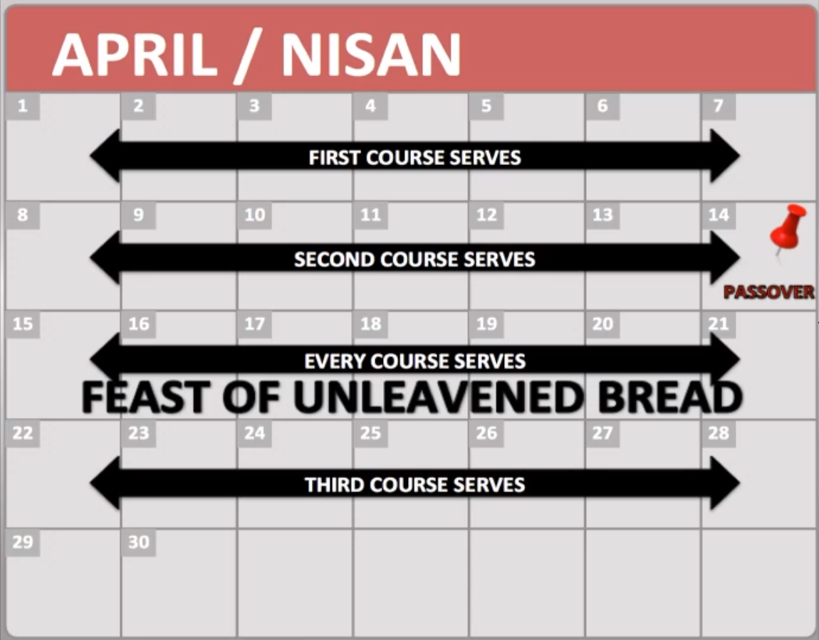

Slide 328
THERE ARE SCRIPTURES TO GIVE Credibility TO THIS PREMISE that yeshua was born on sukkoth
Source #11: Luke 1:5-25
Mark also noted that those who were in the second course had to stay in the Feast of Unleavened Bread week, and those who were in the third course had to do stay the week after Unleavened Bread week to do their regular Priestly Offices.

Slide 329
THERE ARE SCRIPTURES TO GIVE Credibility TO THIS PREMISE that yeshua was born on sukkoth
Source #11: Luke 1:5-25
These next two charts show the next seven Courses including the week that all of the Priests had to be involved in the Feast of Shavuoth/Pentecost.

Slide 330
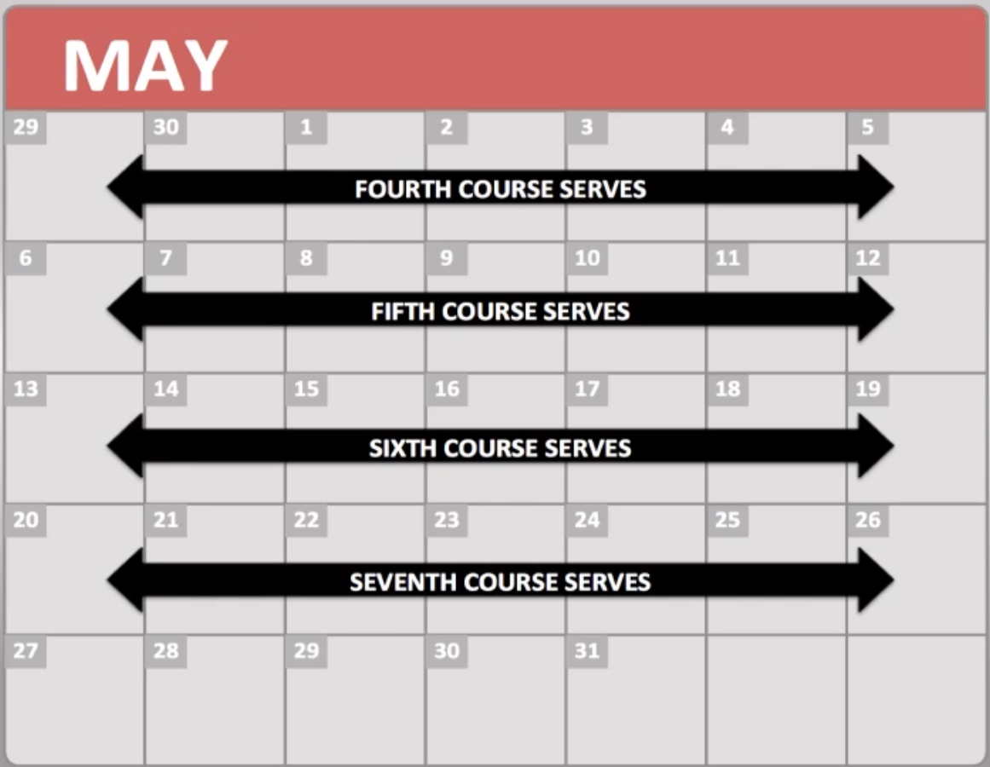
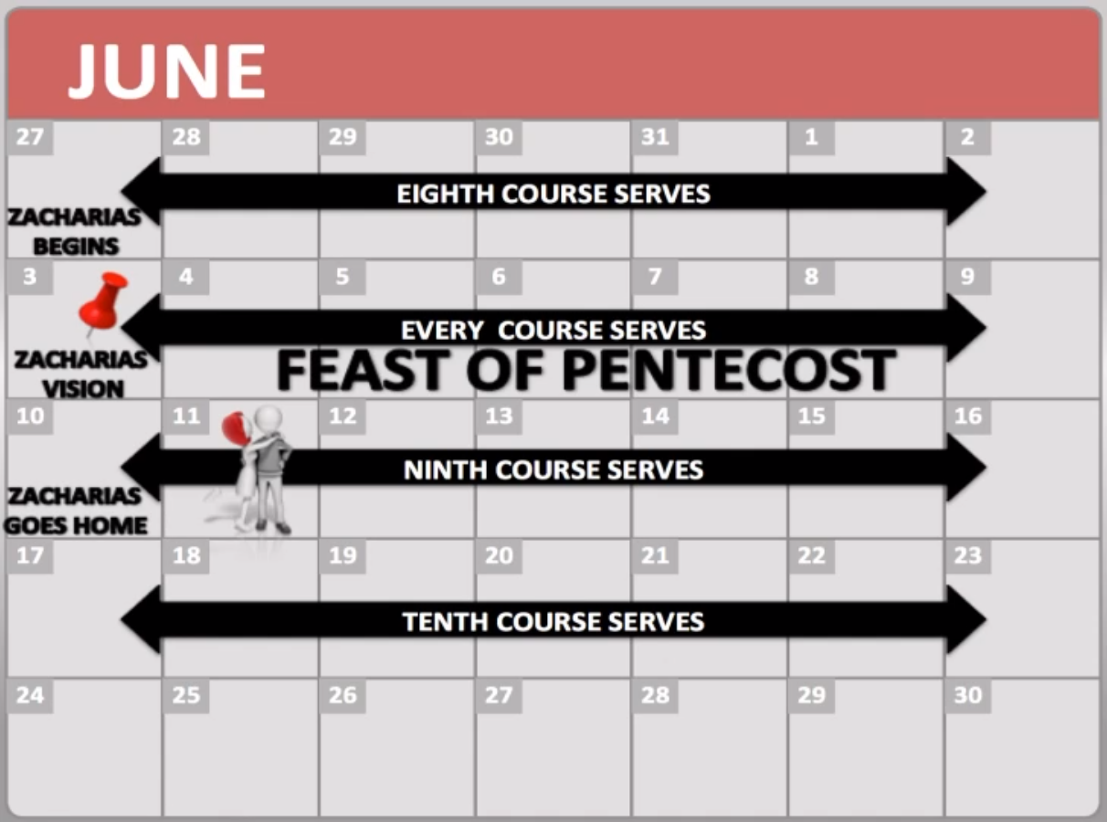

Slide 331
THERE ARE SCRIPTURES TO GIVE Credibility TO THIS PREMISE that yeshua was born on sukkoth
Source #11: Luke 1:5-25
The latter chart shows that Zecharias' course which is the Eighth Course started on the week before Shavuoth/Pentecost. The next week of the week of Shavuoth/Pentecost shows that all of the Priests Offices had to be involved, including Zecharias’ Course. Mark noted that it was on Shavuoth/Pentecost that Zecharias was visited by the angel, Gabriel. Based on Mark Biltz's revelation, it would have placed the full first month of Elizabeth's pregnancy thirty days after her conception with John on the Feast of Shavuoth/Pentecost,

Slide 332
THERE ARE SCRIPTURES TO GIVE Credibility TO THIS PREMISE that yeshua was born on sukkoth
Source #11: Luke 1:5-25
It was already noted in the beginning of this teaching that the angel, Gabriel, visited Mary on the Feast of Khanukkah, and at that time, Elizabeth was six months pregnant.

Slide 333
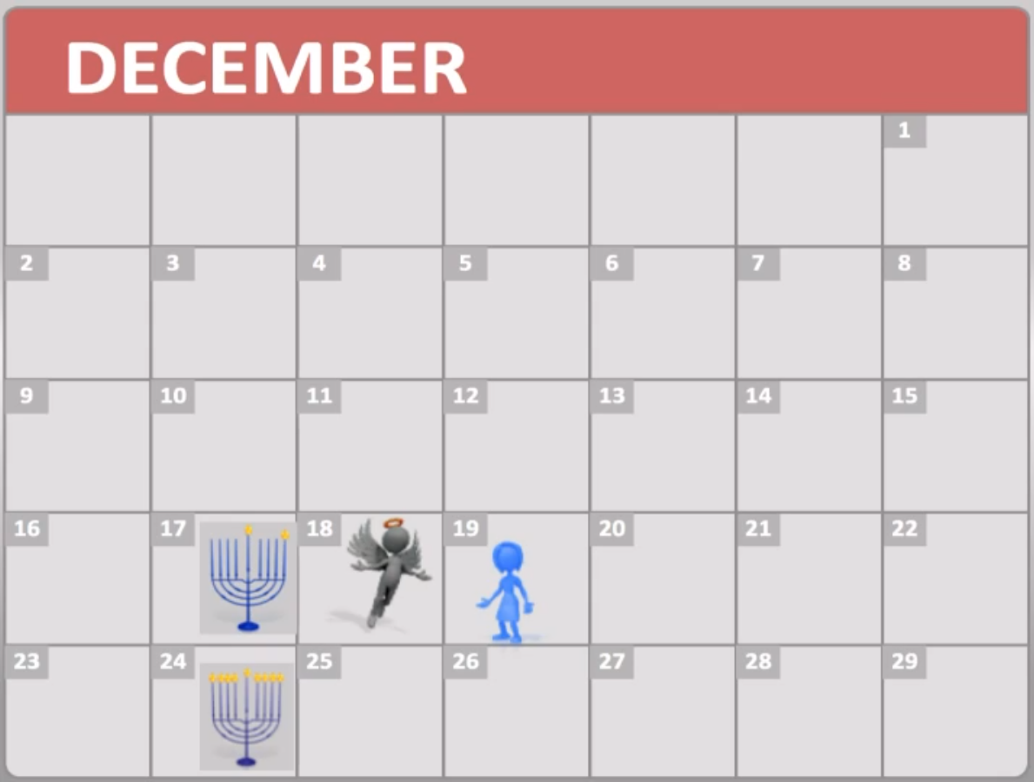

Slide 334
THERE ARE SCRIPTURES TO GIVE Credibility TO THIS PREMISE that yeshua was born on sukkoth
Source #11: Luke 1:5-25
Mark Biltz also revealed that the ninth month of Elizabeth's pregnancy arrived on the week of the Feast of Unleavened Bread, and that was when John the Baptist/Immerser was born. By the time of John's birth, Mary was three months pregnant with Yeshua. Adding six months to the ninth month of Mary's preganancy, it arrives at the time of the Feast of Sukkoth, which would make it the time of Yeshua's birth.

Slide 335
SOURCE NUMBER TWELVE:

Slide 336
Luke 2:1-7

Slide 337
THERE ARE SCRIPTURES TO GIVE Credibility TO THIS PREMISE that yeshua was born on sukkoth
Source #12: Luke 2:1-7
1 And it came to pass in those days, that there went out a decree from Caesar Augustus, that all of the world should be taxed. 2 (And this taxing was first made when Cyrenius was Governor of Syria.) 3 And all went to be taxed, every one into his own city.

Slide 338
THERE ARE SCRIPTURES TO GIVE Credibility TO THIS PREMISE that yeshua was born on sukkoth
Source #12: Luke 2:1-7
4 And Joseph also went up from Galilee, out of the city of Nazareth, into Judaea, unto the City of David, which is called Bethlehem; (because he was of the house and lineage of David:) 5 To be taxed with Mary his espoused wife, being great with Child.

Slide 339
THERE ARE SCRIPTURES TO GIVE Credibility TO THIS PREMISE that yeshua was born on sukkoth
Source #12: Luke 2:1-7
6 And so it was, that, while they were there, the days were accomplished that she should be delivered. 7 And she brought forth her Firstborn Son, and wrapped Him in swaddling clothes, and laid Him in a manger; because there was no room for them in the inn.

Slide 340
THERE ARE SCRIPTURES TO GIVE Credibility TO THIS PREMISE that yeshua was born on sukkoth
Source #12: Luke 2:1-7
There is no clear explanation to why Caesar Augustus took a census in Judaea, but יהוה used that as the “opportune time” for His Son to be born in Bethlehem, which in the Gregorian Calendar would have been around 3 BC, nearing the time of… what else?... The Feast of Sukkoth!!!

Slide 341
THERE ARE SCRIPTURES TO GIVE Credibility TO THIS PREMISE that yeshua was born on sukkoth
Source #12: Luke 2:1-7
Cyrenius’ name was Publius Sulpicius Quirinius. There are sources that say there is no evidence that Quirinius was governor in Syria during Yeshua’s birth, but there are others that say there is proof that Quirinius was present during Yeshua’s birth.

Slide 342
THERE ARE SCRIPTURES TO GIVE Credibility TO THIS PREMISE that yeshua was born on sukkoth
Source #12: Luke 2:1-7
A website called The Evangelical Theological Society puts out a journal called Journal of the Evangelical Theological Society (abbreviated as JETS). They have an article in their March 2011 JETS Journal, Volume 54, No. 1, written by John H. Rhodes titled “Josephus Misdated the Census of Quirinius”. The article is twenty three pages long, but I have posted excerpts of this article. This is what it says:

Slide 343
THERE ARE SCRIPTURES TO GIVE Credibility TO THIS PREMISE that yeshua was born on sukkoth
Source #12: Luke 2:1-7
"[page 65-66] "Quirinius was sent into the region on the twofold mission to take the census and to secure the property of Archelaus at the time of his exile. Second, Josephus asserts an explicit date for this census—in the 37th year from Caesar’s defeat of Antony at Actium in 31 BC, that is, in AD 6 (Ant. XVIII, 26–28). Finally, Luke’s one sentence suggesting that Quirinius was the governor of Syria at the time of the Jesus’ birth adds a further complication since Josephus reports that Varus was governor of Syria from the last years of Herod the Great until after Herod’s death and that Saturninus was Syria’s governor before Varus. Consequently, without an a priori assumption of Luke’s accuracy, this evidence lends greater plausibility to the account of Josephus....

Slide 344
THERE ARE SCRIPTURES TO GIVE Credibility TO THIS PREMISE that yeshua was born on sukkoth
Source #12: Luke 2:1-7
[page 85] "However, if the census account has been misplaced, we must also speculate on how the census came to be dated explicitly to AD 6, the 37th year from Actium, if it indeed happened earlier. Perhaps, when writing Antiquities, Josephus found that his source on the census reported the 27th year of Actium which he misread as the 37th. Or, perhaps his source reported the 37th year of Herod (from his Roman appointment), and Josephus changed it to Actium for the same reason. Before dismissing this possibility of misreading a source as too unlikely, one should note that Josephus also asserted explicitly that Herod was only 15 years old when he was given charge of Galilee, an assertion that many scholars assume was a misreading of 25. 39 So, perhaps the explicit date stemmed from a simple misreading of his source....

Slide 345
THERE ARE SCRIPTURES TO GIVE Credibility TO THIS PREMISE that yeshua was born on sukkoth
Source #12: Luke 2:1-7
[page 86-87] "Second, although the high priesthood data is still diffcult, having Joazar active in bringing about cooperation in the taxation also fits the time of Herod the Great better than assuming a variety of unrecorded appointments in order to account for the multiple deposals. Herod exalted Joazar to the high priesthood in opposition to the supporters of Judas, and his deposal by either Sabinus/Quirinius or Archelaus after the disturbances associated with Herod’s death makes sense while an AD 6 deposal by Quirinius does not. Third, by identifying Quirinius and Sabinus, we not only have the man responsible for the census located in Judea during the last days of Herod the Great and an explanation for the earlier reference to Coponius at Antipater’s trial but also a very plausible rationale for the extraordinary behavior of Sabinus. Certainly, these three sets of data taken individually may not be ultimately persuasive, but one must consider their combined weight for adding greater plausibility to the account of Luke."

Slide 346
THERE ARE SCRIPTURES TO GIVE Credibility TO THIS PREMISE that yeshua was born on sukkoth
Source #12: Luke 2:1-7
You can access the webpage by copying and pasting the link below to your browser address box:
http://www.etsjets.org/files/JETS-PDFs/54/54-1/JETS_54-1_65-87_Rhoads.pdf

Slide 347
THERE ARE SCRIPTURES TO GIVE Credibility TO THIS PREMISE that yeshua was born on sukkoth
Source #12: Luke 2:1-7
Another website called Associated For Scriptural Knowledge has an interesting article titled “The Census Quintillius Varus”. You can access the webpage by copying and pasting the link below to your browser’s address box.
http://www.askelm.com/star/star014.htm#_ednref21

Slide 348
THERE ARE SCRIPTURES TO GIVE Credibility TO THIS PREMISE that yeshua was born on sukkoth
Source #12: Luke 2:1-7
The Bible Hub website under the topical Bible topic of Cyrenius posted the Smith’s Bible Dictionary topic of Cyernius. This is what it says:

Slide 349
THERE ARE SCRIPTURES TO GIVE Credibility TO THIS PREMISE that yeshua was born on sukkoth
Source #12: Luke 2:1-7
Smith's Bible Dictionary
Cyrenius
"(warrior), the Greek form of the Roman name of Quirinus. The full name is Publius Sulpicius Quirinus. He was consul B.C. 12, and was made governor of Syria after the banishment of Archelaus in A.D. 6. He probably was twice governor of Syria; his first governorship extended from B.C. 4 (the year of Christ's birth) to B.C. 1. It was during this time that he was sent to make the enrollment which caused Joseph and Mary to visit Bethlehem. (Luke 2:2) The second enrollment is mentioned in (Acts 5:37)"

Slide 350
THERE ARE SCRIPTURES TO GIVE Credibility TO THIS PREMISE that yeshua was born on sukkoth
Source #12: Luke 2:1-7
Bible Hub also posted the Easton Illustrated Bible Dictionary’s topic on Cyrenius showing Quirinius (Cyrenius) time line in connection with Yeshua’s birth. This is what it says:

Slide 351
THERE ARE SCRIPTURES TO GIVE Credibility TO THIS PREMISE that yeshua was born on sukkoth
Source #12: Luke 2:1-7
Easton's Bible Dictionary
"The Grecized form of Quirinus. His full name was Publius Sulpicius Quirinus. Recent historical investigation has proved that Quirinus was governor of Cilicia, which was annexed to Syria at the time of our Lord's birth. Cilicia, which he ruled, being a province of Syria, he is called the governor, which he was de jure, of Syria. Some ten years afterwards he was appointed governor of Syria for the second time. During his tenure of office, at the time of our Lord's birth (Luke 2:2), a "taxing" (R.V., "enrolment;" i.e., a registration) of the people was "first made;" i.e., was made for the first time under his government."

Slide 352
THERE ARE SCRIPTURES TO GIVE Credibility TO THIS PREMISE that yeshua was born on sukkoth
Source #12: Luke 2:1-7
You can access this webpage by copying and pasting the link below to your browser’s address box.
http://biblehub.com/topical/c/cyrenius.htm

Slide 353
THERE ARE SCRIPTURES TO GIVE Credibility TO THIS PREMISE that yeshua was born on sukkoth
Source #12: Luke 2:1-7
It is theory that Caesar Augustus either knew or his advisors knew that the Jews would be celebrating the Feast of Sukkoth in Judea to the Jerusalem area based on Scripture that the Jews were to come to Jerusalem on Sukkoth as one of the requirements three times in the year they were to go there and to not appear empty handed, in which they would bring money. This is taken from the book of Deuteronomy

Slide 354
THERE ARE SCRIPTURES TO GIVE Credibility TO THIS PREMISE that yeshua was born on sukkoth
Source #12: Luke 2:1-7
Deuteronomy 16:16 Three times in the year, all of your males shall be seen toward את-the Face of יהוה, your Elohim, in the Place which shall be chosen; in the Feast of the Unleavened Bread, and in the Feast of the Weeks, and in the Feast of the Sukkoth (Tabernacles): and shall not be seen empty toward את-the Face of יהוה : 17 a man according to the gift of his hand, according to the blessing of יהוה, your Elohim, which was given to you.

Slide 355
TTHERE ARE SCRIPTURES TO GIVE Credibility TO THIS PREMISE that yeshua was born on sukkoth
Source #12: Luke 2:1-7
Caesar Agustus could have been advised that it would be a convenience to tax all of the Jews while they were all together in Judea and not be spread out to retrieve the taxes in both in Judea and in Samaria, thus saving manual labor and money for the government.

Slide 356
THERE ARE SCRIPTURES TO GIVE Credibility TO THIS PREMISE that yeshua was born on sukkoth
Source #12: Luke 2:1-7
We need to remember that the majority who went to Judea were all from the Southern house of Judah in which Joseph was of the house of David in Bethlehem). Most of the Northern House of Israel/Ephraim/Joseph were exiled from the land over 720 years prior, and were scattered throughout the nations, and about all of the remnant who were the Samaritans were not allowed to go to Jerusalem.

Slide 357
THERE ARE SCRIPTURES TO GIVE Credibility TO THIS PREMISE that yeshua was born on sukkoth
Source #12: Luke 2:1-7
Mark Biltz of El Shaddai Ministries noted that the reason there was no room in the inn, because the children of Israel were there for the Feast of Sukkoth.

Slide 358
SOURCE NUMBER THIRTEEN:

Slide 359
John 7:2, 14, 21-23

Slide 360
THERE ARE SCRIPTURES TO GIVE Credibility TO THIS PREMISE that yeshua was born on sukkoth
Source #13: John 7:2, 14, 21-23
2 Now the Jews' Feast of Tabernacles was at hand.... 14 Now about the midst of the Feast, Yeshua went up into the Temple, and taught.... 21 Yeshua answered and said unto them, I have done one Work, and ye all marvel.

Slide 361
THERE ARE SCRIPTURES TO GIVE Credibility TO THIS PREMISE that yeshua was born on sukkoth
Source #13: John 7:2, 14, 21-23
22 Moses therefore gave unto you Circumcision; (not because it is of Moses, but of the fathers;) and ye on the Shabbath day circumcise a man. 23 If a man on the Shabbath day receive circumcision, that the Torah of Moses should not be broken; are ye angry at Me, because I have made a man every whit whole on the Shabbath Day?

Slide 362
THERE ARE SCRIPTURES TO GIVE Credibility TO THIS PREMISE that yeshua was born on sukkoth
Source #13: John 7:2, 14, 21-23
Yeshua was at Jerusalem during the Feast of Sukkoth as it is commanded for all of the males to do, which is noted in the book of Exodus and Deuteronomy

Slide 363
THERE ARE SCRIPTURES TO GIVE Credibility TO THIS PREMISE that yeshua was born on sukkoth
Source #13: John 7:2, 14, 21-23
Exodus 23:14 Three times you will feast to Me in the year. 15 You will keep אתthe Feast of the Unleavened Bread: seven days you will eat unleavened bread as which I have commanded you to the Appointed Time of the month of the Aviv; for on him, you came out from Egypt: and they shall not appear My Face empty: 16 And the Feast of the Harvest, the firstfruits of your labors, which you have sown in the field: and the Feast of the Ingathering in the going out of the year in your gatheringאת -your work from the field. 17 Three times in the year shall all of your males appear to the Face of the Adon יהוה.

Slide 364
THERE ARE SCRIPTURES TO GIVE Credibility TO THIS PREMISE that yeshua was born on sukkoth
Source #13: John 7:2, 14, 21-23
Deuteronomy 16:16 Three times in the year, all of your males shall be seen toward את-the Face of יהוה, your Elohim, in the Place which shall be chosen; in the Feast of the Unleavened Bread, and in the Feast of the Weeks, and in the Feast of the Sukkoth (Tabernacles): and shall not be seen empty toward את-the Face of יהוה : 17 a man according to the gift of his hand, according to the blessing of יהוה, your Elohim, which was given to you.

Slide 365
THERE ARE SCRIPTURES TO GIVE Credibility TO THIS PREMISE that yeshua was born on sukkoth
Source #13: John 7:2, 14, 21-23
By the time this Scripture source occurred, it was half way into the Feast of Sukkoth, which means it was on the fourth day, and based on this Scripture account, this could have occurred on a regular Shabbath day. (According to Scott Aaron of Zealous For Zion, it occurred on Tuesday day).

Slide 366
THERE ARE SCRIPTURES TO GIVE Credibility TO THIS PREMISE that yeshua was born on sukkoth
Source #13: John 7:2, 14, 21-23
Nevertheless, Yeshua was making the Jews realize that they had to circumcise a male child who was born on a regular Shabbath on his eighth day of the life on a regular Shabbath in order for the Torah to not to be broken, and if they didn't do it on a regular Shabbath, they would be breaking the Torah.

Slide 367
THERE ARE SCRIPTURES TO GIVE Credibility TO THIS PREMISE that yeshua was born on sukkoth
Source #13: John 7:2, 14, 21-23
Yeshua mentioned this to the Jews on a regular Shabbath, because He, Himself, could have been circumcised on a regular Shabbath, which would have been the eighth day of his life during the day of the Solemn Assembly. Since Yeshua was born on the first day of Sukkoth, which was High Shabbath, He had to be circumcised on the eighth day on a High Shabbath, and both High Shabbaths during Yeshua’s first eight days of life on earth could have fallen on the regular Shabbaths.

Slide 368
SOURCE NUMBER FOURTEEN:

Slide 369
John 8:56-58

Slide 370
THERE ARE SCRIPTURES TO GIVE Credibility TO THIS PREMISE that yeshua was born on sukkoth
Source #14: John 8:56-58
56 Your father Abraham rejoiced to see My Day: and he saw it, and was glad. 57 Then said the Jews unto Him, Thou art not yet fifty years old, and hast Thou seen Abraham? 58 Yeshua said unto them, Verily, verily, I say unto you, Before Abraham was, I AM.

Slide 371
THERE ARE SCRIPTURES TO GIVE Credibility TO THIS PREMISE that yeshua was born on sukkoth
Source #14: John 8:56-58
Yeshua most likely spoke this Scripture source on the seventh day during the Feast of Sukkoth to the Pharisees and the Jewish People. Based on this Scripture account, it reveals that He, Himself, met Abraham on the first day of Sukkoth before it became part of the Torah.

Slide 372
THERE ARE SCRIPTURES TO GIVE Credibility TO THIS PREMISE that yeshua was born on sukkoth
Source #14: John 8:56-58
This should have also give them a hint that it was Yeshua telling Abraham on the first day of Sukkoth, that at the time, Sarah will have a son named Isaac who will be born on the first day of Sukkoth and circumcised on the eighth day of the Solemn Assembly, and this was a type and shadow of Yeshua being born on the first day of Sukkoth.

Slide 373
John 7:2 through 10:21 was a recording of the events of the seven days of the Feast of Sukkoth and the one day of the Solemn Assembly.
(Note: I will include the dates of Scott Aaron of Zealous For Zion in which He says the days of Sukkoth in John's account occurred, which will be colored in blue):

Slide 374
John 7:2-10 Day Before Sukkoth (Tishri 14th): Tuesday Day (3rd day of the week) (Friday Day (6th Day of the Week))

Slide 375
John 7:2-10 Day Before Sukkoth (Tishri 14th): Tuesday Day (3rd day of the week) (Friday Day (6th Day of the Week))
John 7:11-13 1st day of Sukkoth (Tishri 15th): Tuesday Night (4th day of the week) (Friday Night (Shabbath))

Slide 376
John 7:2-10 Day Before Sukkoth (Tishri 14th): Tuesday Day (3rd day of the week) (Friday Day (6th Day of the Week))
John 7:11-13 1st day of Sukkoth (Tishri 15th): Tuesday Night (4th day of the week) (Friday Night (Shabbath))
John 7:14-36 4th day of Sukkoth (Tishri 18th): Possiblly Saturday Day (Shabbath) (Possibly Tuesday Day (4th Day of the Week))

Slide 377
John 7:2-10 Day Before Sukkoth (Tishri 14th): Tuesday Day (3rd day of the week) (Friday Day (6th Day of the Week))
John 7:11-13 1st day of Sukkoth (Tishri 15th): Tuesday Night (4th day of the week) (Friday Night (Shabbath))
John 7:14-36 4th day of Sukkoth (Tishri 18th): Possiblly Saturday Day (Shabbath) (Possibly Tuesday Day (4th Day of the Week))
John 7:37-8:1 7th day of Sukkoth (Tishri 21st): Monday Night (3rd day of the week) (Thursday Night (6th Day of the Week))

Slide 378
John 7:2-10 Day Before Sukkoth (Tishri 14th): Tuesday Day (3rd day of the week) (Friday Day (6th Day of the Week))
John 7:11-13 1st day of Sukkoth (Tishri 15th): Tuesday Night (4th day of the week) (Friday Night (Shabbath))
John 7:14-36 4th day of Sukkoth (Tishri 18th): Possiblly Saturday Day (Shabbath) (Possibly Tuesday Day (4th Day of the Week))
John 7:37-8:1 7th day of Sukkoth (Tishri 21st): Monday Night (3rd day of the week) (Thursday Night (6th Day of the Week))
John 8:2-59 7th day of Sukkoth (Tishri 21st): Tuesday Day (3rd day of the week) (Friday Day (6th Day of the Week))

Slide 379
John 7:2-10 Day Before Sukkoth (Tishri 14th): Tuesday Day (3rd day of the week) (Friday Day (6th Day of the Week))
John 7:11-13 1st day of Sukkoth (Tishri 15th): Tuesday Night (4th day of the week) (Friday Night (Shabbath))
John 7:14-36 4th day of Sukkoth (Tishri 18th): Possiblly Saturday Day (Shabbath) (Possibly Tuesday Day (4th Day of the Week))
John 7:37-8:1 7th day of Sukkoth (Tishri 21st): Monday Night (3rd day of the week) (Thursday Night (6th Day of the Week))
John 8:2-59 7th day of Sukkoth (Tishri 21st): Tuesday Day (3rd day of the week) (Friday Day (6th Day of the Week))
John 9:1-12 7th day of Sukkoth (Tishri 21st): Tuesday Before Sunset (3rd day of the week)
(Friday Afternoon Before Sunset (6th Day of the Week))

Slide 380
John 7:2-10 Day Before Sukkoth (Tishri 14th): Tuesday Day (3rd day of the week) (Friday Day (6th Day of the Week))
John 7:11-13 1st day of Sukkoth (Tishri 15th): Tuesday Night (4th day of the week) (Friday Night (Shabbath))
John 7:14-36 4th day of Sukkoth (Tishri 18th): Possiblly Saturday Day (Shabbath) (Possibly Tuesday Day (4th Day of the Week))
John 7:37-8:1 7th day of Sukkoth (Tishri 21st): Monday Night (3rd day of the week) (Thursday Night (6th Day of the Week))
John 8:2-59 7th day of Sukkoth (Tishri 21st): Tuesday Day (3rd day of the week) (Friday Day (6th Day of the Week))
John 9:1-12 7th day of Sukkoth (Tishri 21st): Tuesday Before Sunset (3rd day of the week)
(Friday Afternoon Before Sunset (6th Day of the Week))
John 9:13-10:21 8th day- Solemn Assembly (Tishri 22nd): Tuesday Night (4th day of the week)
(Friday Night (Shabbath))

Slide 381
Based on John 7:2 through 10:21, it is possible that the seven days of Sukkoth and the one day of the Solemn Assembly started on Tuesday night and ended on the next Tuesday night. According to Scott Aaron of Zealous For Zion, it started on Friday night and ended on the next Friday night.

Slide 382
In my viewpoint, Tuesday night is the fourth day of the week. To יהוה, a thousand years is as a day, which the apostle Peter noted in his epistle

Slide 383
2 Peter 3:8 But, beloved, be not ignorant of this one thing, that one day is with the Adon as a thousand years, and a thousand years as one day.

Slide 384
Also in my viewpoint, the Sukkoth year that Yeshua appeared in the Gospel of John occurred in the four thousandth year, the year, or Kingdom Day, of Yeshua.

Slide 385
The fourth day of Creation was when the celestials were created in the heavens, which is noted in the book of Genesis

Slide 386
Genesis 1:14 And Elohim said, Be luminaries in the firmament of the heavens for the division between the day and between the night, and shall be for signs, and for appointed times, and for days, and years, 15 and shall be for luminaries in the firmament of the heavens for the lighting upon the earth. And became so. 16 And Elohim madeאת -the two great luminaries:את -the great luminary to rule the day andאת -the small luminary to rule the night, and אתthe stars. 17 And Elohim set them in the firmament of the heavens for the lighting upon the earth. 18 And for ruling in the day and in the night and for the separation between the light and between the darkness, and Elohim saw for goodness. 19 And became mixing period (evening), and became breaking (morning): Fourth day.

Slide 387
Based on this Scripture account, the year that Yeshua came down to earth to be born of Flesh would fit the time line of the fourth day of Creation where He would have descended from the heavens, where the celestials were made, to earth to live with mankind.

Slide 388
SUMMARY

Slide 389
Looking at the summary of the proof that Yeshua was born on Sukkoth:

Slide 390
SUMMARY of the proof that yeshua was born on sukkoth
Yeshua was born on the first day of Sukkoth and was circumcised on the eighth day on the Day of Solemn Assembly.

Slide 391
SUMMARY of the proof that yeshua was born on sukkoth
Yeshua was born on the first day of Sukkoth and was circumcised on the eighth day on the Day of Solemn Assembly.
Yeshua birth and circumcision days were on the conjunctions of the regular Shabbath days and the high Shabbath days.

Slide 392
SUMMARY of the proof that yeshua was born on sukkoth
Yeshua was born on the first day of Sukkoth and was circumcised on the eighth day on the Day of Solemn Assembly.
Yeshua birth and circumcision days were on the conjunctions of the regular Shabbath days and the high Shabbath days.
Yeshua met Abraham on the first day of the first Feast of Sukkoth before יהוה made it an official High Holy Day.

Slide 393
SUMMARY of the proof that yeshua was born on sukkoth
Yeshua was born on the first day of Sukkoth and was circumcised on the eighth day on the Day of Solemn Assembly.
Yeshua birth and circumcision days were on the conjunctions of the regular Shabbath days and the high Shabbath days.
Yeshua met Abraham on the first day of the first Feast of Sukkoth before יהוה made it an official High Holy Day.
The story of Isaac’s birth and circumcision and יהוה’s visitation to Sarah was a type and shadow of Yeshua’s visitation on earth to be born on Sukkoth and circumcised on the Solemn Assembly.

Slide 394
SUMMARY of the proof that yeshua was born on sukkoth
Genesis chapter twenty four was a type and shadow of the Fall High Holy Days, Abraham’s servant, Eliezer, a symbol as the Ruakh HaKodesh (the Holy Spirit), and Rebekah was Isaac’s Sukkoth birthday present as a Sukkoth bride.

Slide 395
SUMMARY of the proof that yeshua was born on sukkoth
Genesis chapter twenty four was a type and shadow of the Fall High Holy Days, Abraham’s servant, Eliezer, a symbol as the Ruakh HaKodesh (the Holy Spirit), and Rebekah was Isaac’s Sukkoth birthday present as a Sukkoth bride.
King Solomon’s profession during the Temple dedication and asking if Elohim can dwell on the earth on the first day of Sukkoth was a prophetic hint that Yeshua would be born on the first day of Sukkoth.

Slide 396
SUMMARY of the proof that yeshua was born on sukkoth
Genesis chapter twenty four was a type and shadow of the Fall High Holy Days, Abraham’s servant, Eliezer, a symbol as the Ruakh HaKodesh (the Holy Spirit), and Rebekah was Isaac’s Sukkoth birthday present as a Sukkoth bride.
King Solomon’s profession during the Temple dedication and asking if Elohim can dwell on the earth on the first day of Sukkoth was a prophetic hint that Yeshua would be born on the first day of Sukkoth.
The Gospel of John’s account of Yeshua coming to earth to dwell, or “tabernacle”, on the earth fulfilled the prophetic hint from the account of king Solomon’s dedication of the Temple on Sukkoth that Yeshua was born on the first day of Sukkoth.

Slide 397
SUMMARY of the proof that yeshua was born on sukkoth
The Parable of the Ten Virgins in Matthew 25:1-13 were types and shadows of the Fall High Holy Days and symbolizing us as believers for Yeshua’s birthday present on Sukkoth as His Bride, and is comparable to the Genesis chapter twenty four account.

Slide 398
SUMMARY of the proof that yeshua was born on sukkoth
The Parable of the Ten Virgins in Matthew 25:1-13 were types and shadows of the Fall High Holy Days and symbolizing us as believers for Yeshua’s birthday present on Sukkoth as His Bride, and is comparable to the Genesis chapter twenty four account.
Zacharius' course was the eighth course of Abijah which based on the accounts would have occurred during the Feast of Shavuoth/Pentecost.

Slide 399
SUMMARY of the proof that yeshua was born on sukkoth
The Parable of the Ten Virgins in Matthew 25:1-13 were types and shadows of the Fall High Holy Days and symbolizing us as believers for Yeshua’s birthday present on Sukkoth as His Bride, and is comparable to the Genesis chapter twenty four account.
Zacharius' course was the eighth course of Abijah which based on the accounts would have occurred during the Feast of Shavuoth/Pentecost.
The time line of Elizabeth's conception of John on the Feast of Shavuoth/Pentecost and Mary's conception on the Feast of Khanukkah during the sixth month of Elizabeth's pregnancy fit into the time line that Yeshua would have been born on the first day of Sukkoth.

Slide 400
SUMMARY of the proof that yeshua was born on sukkoth
The Parable of the Ten Virgins in Matthew 25:1-13 were types and shadows of the Fall High Holy Days and symbolizing us as believers for Yeshua’s birthday present on Sukkoth as His Bride, and is comparable to the Genesis chapter twenty four account.
Zacharius' course was the eighth course of Abijah which based on the accounts would have occurred during the Feast of Shavuoth/Pentecost.
The time line of Elizabeth's conception of John on the Feast of Shavuoth/Pentecost and Mary's conception on the Feast of Khanukkah during the sixth month of Elizabeth's pregnancy fit into the time line that Yeshua would have been born on the first day of Sukkoth.
Yeshua speaking to the Jewish People at the Temple in Jerusalem during the Feast of Sukkoth, speaking of someone being circumcised on the Shabbath Day on Sukkoth was a hint to the Jewish People that Yeshua was circumcised on the eighth day of the Solemn Assembly on a regular Shabbath Day.

Slide 401
SUMMARY of the proof that yeshua was born on sukkoth
Yeshua spoke to the Pharisees and the Jewish People at the Temple in Jerusalem during the Feast of Sukkoth, and spoke of His visitation to Abraham that occurred on the first day of Sukkoth, which should have hinted them that when Yeshua told Abraham Sarah will have a son named Isaac on the first day of Sukkoth and was circumcised on the day of the Solemn Assembly, who would be a type and shadow of Yeshua to be born on the same day.

Slide 402
SUMMARY of the proof that yeshua was born on sukkoth
Yeshua spoke to the Pharisees and the Jewish People at the Temple in Jerusalem during the Feast of Sukkoth, and spoke of His visitation to Abraham that occurred on the first day of Sukkoth, which should have hinted them that when Yeshua told Abraham Sarah will have a son named Isaac on the first day of Sukkoth and was circumcised on the day of the Solemn Assembly, who would be a type and shadow of Yeshua to be born on the same day.
Yeshua would have descended on the fourth Kingdom Day, the four thousandth year, of the creation of the celestials to be born on the earth to live with mankind.

Slide 403
יהוה לך כבד
GLORY TO YOU יהוה!!!

Slide 404
ONE MORE VERSE:

Slide 405
Isaiah 9:6

Slide 406
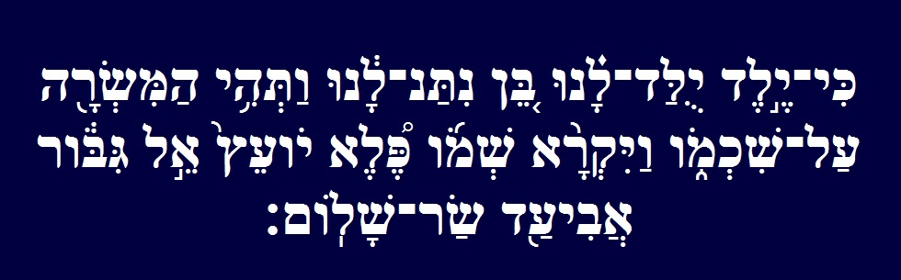
Isaiah 9:6

Slide 407
Isaiah 9:6
6 For a Child was birthed to us, a Son was given to us: and the Government, she shall be upon His Shoulders: and His Name shall be called Wonderful, Counsellor, the Mighty El, the Everlasting Father, the Prince of Peace.

Slide 408
HAVE A GREAT AND JOYFUL SUKKOTH!!!

Slide 409
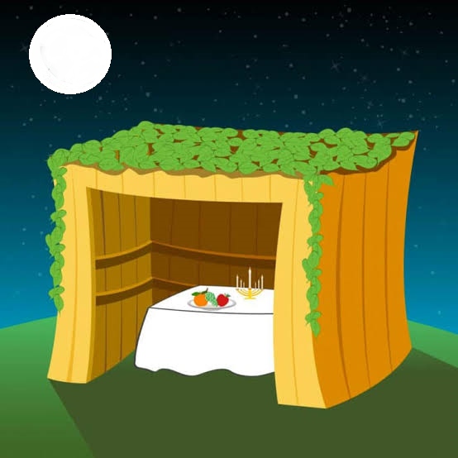
HAPPY BIRTHDAY YESHUA!!!

